Slide 1


Unit – 5
Inner Product Space
B.Tech. $→$1st Semester
Mathematics – I (2601HS101)
Course Outcome:
At the end of this unit, students will be able to demonstrate inner product, orthogonality, QR decompositions, and the least squares solution method.

Slide 2

Topics of Unit 5
  Real Inner Product Space
  Properties of Inner Product and Norm
  Orthogonal and Orthogonal Sets
  Gram-Schmidt Orthogonalization
  QR Decomposition
  Least Squares Solutions
Looping

Slide 3

Outlines of Unit 5
  Real Inner Product Space
  Properties of Inner Product and Norm
  Orthogonal and Orthogonal Sets
  Gram-Schmidt Orthogonalization
  QR Decomposition
  Least Squares Solutions
Looping

Slide 4
Introduction

Slide 5
Introduction
Inner Product Spaces extend the concept of vectors and vector operations beyond Ordinary Euclidean Geometry.
In elementary mathematics, vectors are studied using the dot product, which allows us to measure lengths, distances, and angles. Inner Product Spaces generalize these ideas to more abstract vector spaces such as polynomial spaces, matrix spaces, and spaces of continuous functions.
The concept of an inner product provides a powerful tool for defining important geometric concepts such as Norm, Distance, Orthogonality, and Projection.

Slide 6
Introduction
In this unit, we study
  Inner Products and their properties
  Norms and Distances induced by Inner Products
  Orthogonal and Orthonormal sets, Orthogonal projections
  The Gram–Schmidt Orthogonalization process and Orthogonal Matrices
  QR decomposition and Least Squares Solutions
These concepts play a fundamental role in engineering, computer science, data analysis, machine learning, signal processing, computer graphics, and numerical computations.

Slide 7
Method-1
Real Inner Product Space

Slide 8
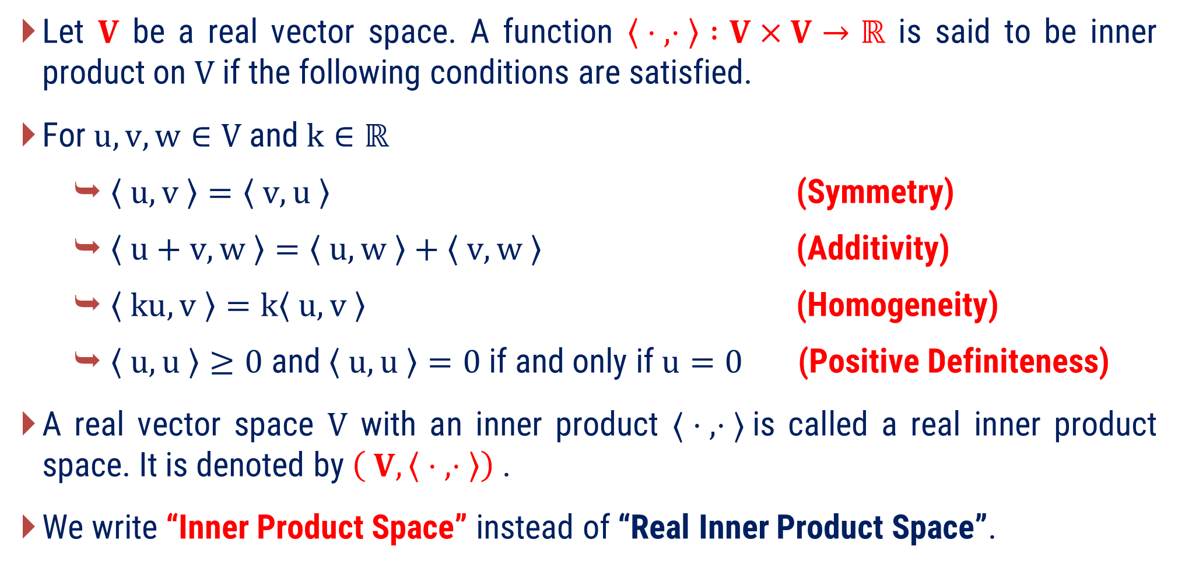
Real Inner Product Space
Let $V$ be a real vector space. A function $〈 ⋅ , ⋅ 〉 :V×V→ℝ$ is said to be inner product on $V$ if the following conditions are satisfied.
For $u, v, w∈V$and$k∈ℝ$
  $〈 u, v 〉=〈 v, u 〉$ (Symmetry)
  $〈 u+v, w 〉=〈 u, w 〉+〈 v,w 〉$ (Additivity)
  $〈 ku,v 〉=k〈 u,v 〉$ (Homogeneity)
  $〈 u, u 〉≥0$ and $〈 u,u 〉=0$if and only if$u=0$ (Positive Definiteness)
A real vector space $V$ with an inner product $〈 ⋅ , ⋅ 〉$is called a real inner product space. It is denoted by $\left( V, 〈 ⋅ , ⋅ 〉\right)$.
We write “Inner Product Space” instead of “Real Inner Product Space”.

Slide 9
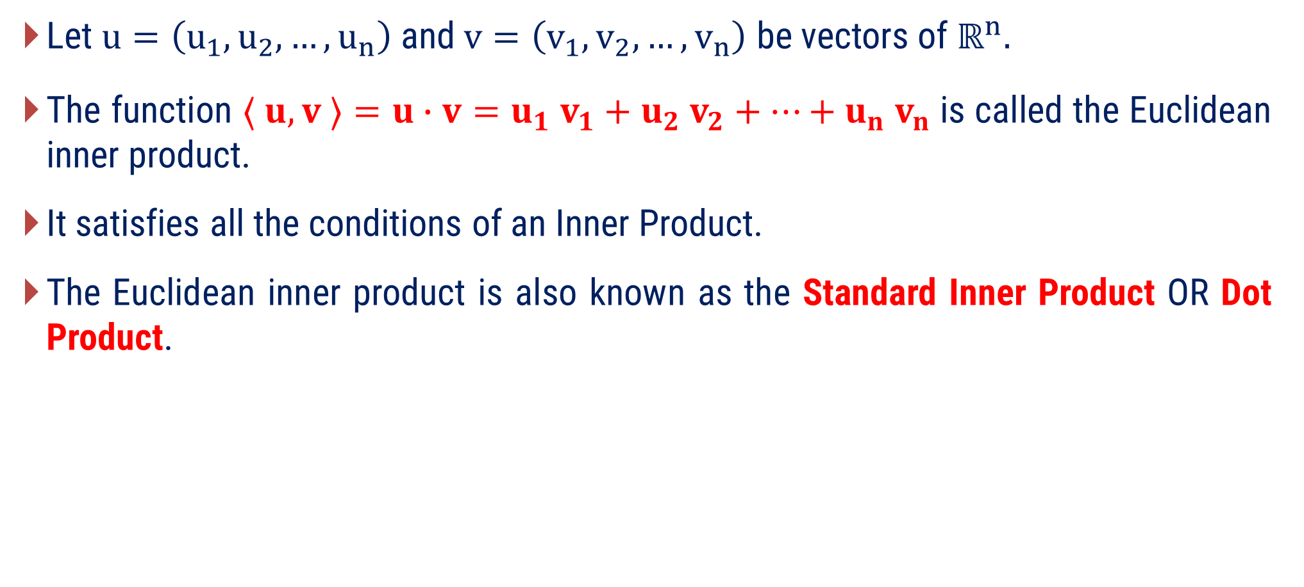
Euclidean Inner Product
Let $u=\left(u_{1},u_{2},…,u_{n}\right)$ and $v=\left(v_{1},v_{2},…,v_{n}\right)$ be vectors of $ℝ^{n}.$
The function $⟨ u,v ⟩=u∙v=u_{1} v_{1}+u_{2} v_{2}+⋯+u_{n} v_{n}$ is called the Euclidean inner product.
It satisfies all the conditions of an Inner Product.
The Euclidean inner product is also known as the Standard Inner Product OR Dot Product.

Slide 10
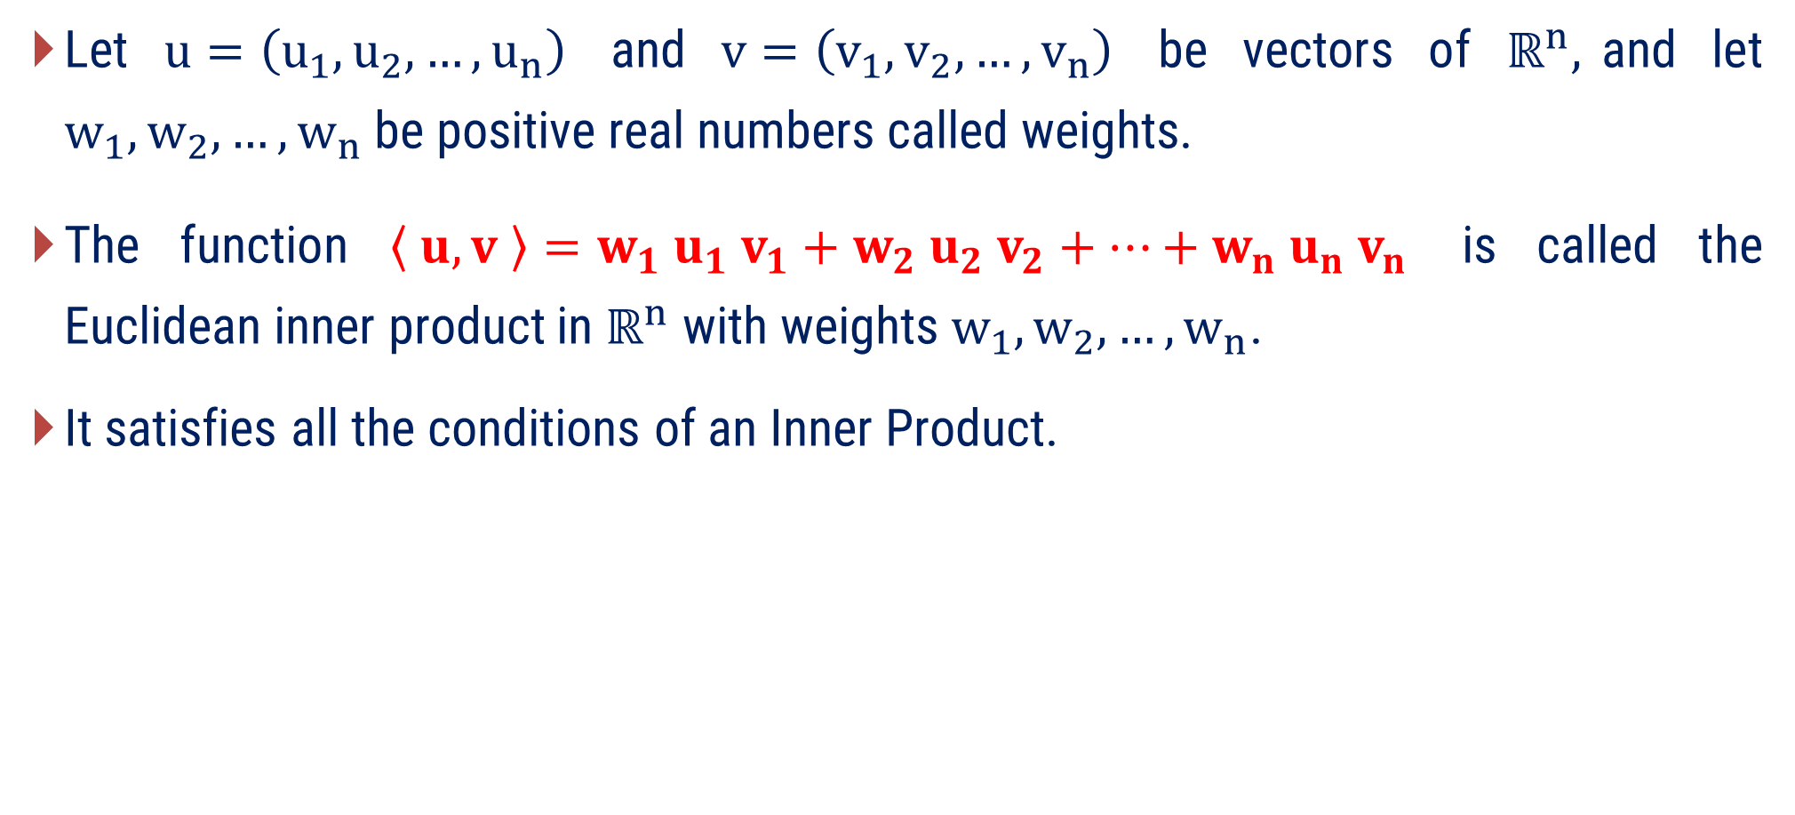
Weighted Euclidean Inner Product
Let $u=\left(u_{1},u_{2},…,u_{n}\right)$ and $v=\left(v_{1},v_{2},…,v_{n}\right)$ be vectors of $ℝ^{n},$and let $w_{1}, w_{2},…,w_{n}$ be positive real numbers called weights.
The function $\left\langle u,v \right\rangle =w_{1} u_{1} v_{1}+w_{2} u_{2} v_{2}+⋯+w_{n} u_{n} v_{n}$ is called the Euclidean inner product in $ℝ^{n}$ with weights $w_{1}, w_{2},…,w_{n}$.
It satisfies all the conditions of an Inner Product.

Slide 11

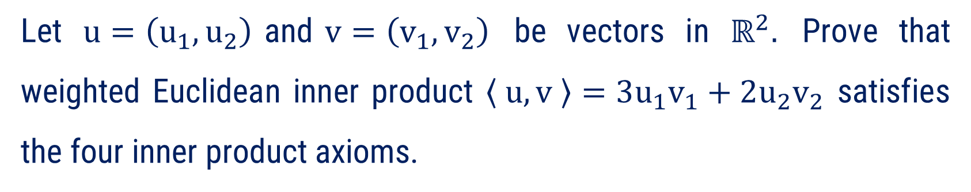



Method:1 $⇝$ Example:1
Example
Let $u=\left(u_{1},u_{2}\right)$and$v=\left(v_{1},v_{2}\right)$ be vectors in $ℝ^{2}.$ Prove that weighted Euclidean inner product $〈 u,v 〉=3u_{1}v_{1}+2u_{2}v_{2}$ satisfies the four inner product axioms.
Solution
Let, $u=\left(u_{1},u_{2}\right),v=\left(v_{1},v_{2}\right),w=\left(w_{1},w_{2}\right)∈ℝ^{2}$ and $k∈ℝ$
Axiom 1: $⟨ u, v ⟩=⟨ v, u ⟩$
Now, $⟨ u, v ⟩=3u_{1}v_{1}+2u_{2}v_{2}$
$$=3v_{1}u_{1}+2v_{2}u_{2}$$
$$=⟨ v, u ⟩$$

Slide 12

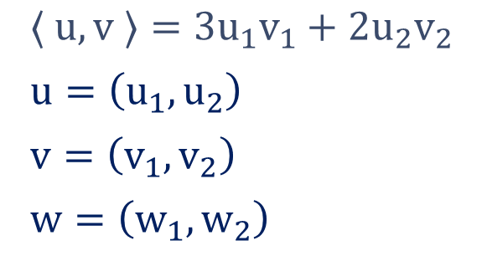






Method:1 $⇝$ Example:1(continue)
Axiom 2: $〈 u+v, w 〉=〈 u, w 〉+〈 v,w 〉$
$$⟨ u, v ⟩=3u_{1}v_{1}+2u_{2}v_{2}$$
$$u=\left(u_{1},u_{2}\right)$$
$$v=\left(v_{1},v_{2}\right)$$
$$w=\left(w_{1},w_{2}\right)$$
Now, $⟨ u+v, w ⟩=$
$$⟨ \left(u_{1},u_{2}\right)+\left(v_{1},v_{2}\right),\left(w_{1},w_{2}\right) ⟩$$
$$=⟨ \left( u_{1}+v_{1},u_{2}+v_{2} \right),\left(w_{1},w_{2}\right) ⟩$$
$$=3\left(u_{1}+v_{1}\right)\left(w_{1}\right)$$
$$+ 2\left(u_{2}+v_{2}\right)\left(w_{2}\right)$$
$$=3u_{1}w_{1}+3v_{1}w_{1}+2u_{2}w_{2}+2v_{2}w_{2}$$
$$=3u_{1}w_{1}+2u_{2}w_{2}+3v_{1}w_{1}+2v_{2}w_{2}$$
$$=⟨ u, w ⟩$$
$$+ ⟨ v, w ⟩$$

Slide 13








Method:1 $⇝$ Example:1(continue)
Axiom 3: $〈 ku, v 〉=k〈 u, v 〉$
$$⟨ u, v ⟩=3u_{1}v_{1}+2u_{2}v_{2}$$
$$u=\left(u_{1},u_{2}\right)$$
$$v=\left(v_{1},v_{2}\right)$$
$$w=\left(w_{1},w_{2}\right)$$
Now, $⟨ ku, v ⟩=$
$$⟨ k\left(u_{1},u_{2}\right),\left(v_{1},v_{2}\right) ⟩$$
$$=⟨ \left( ku_{1},ku_{2} \right),\left(v_{1},v_{2}\right) ⟩$$
$$=3\left(ku_{1}\right)\left(v_{1}\right)$$
$$+ 2\left(ku_{2}\right)\left(v_{2}\right)$$
$$=k \left(3u_{1}v_{1}+2u_{2}v_{2}\right)$$
$$=k ⟨ u, v ⟩$$

Slide 14





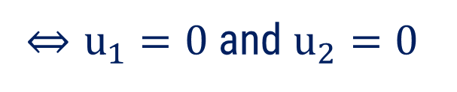



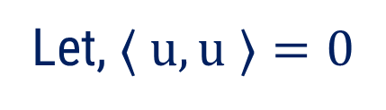
Method:1 $⇝$ Example:1(continue)
Axiom 4: $〈 u, u 〉≥0$ and $〈 u,u 〉=0$iff$u=0$
$$⟨ u, v ⟩=3u_{1}v_{1}+2u_{2}v_{2}$$
$$u=\left(u_{1},u_{2}\right)$$
$$v=\left(v_{1},v_{2}\right)$$
$$w=\left(w_{1},w_{2}\right)$$
Now, $⟨ u, u ⟩=$
$$3u_{1}u_{1}+2u_{2}u_{2}$$
$$=3u_{1}^{2}+2u_{2}^{2}$$
$$≥0$$
$$[ ∵u_{1}^{2},u_{2}^{2}≥0 ]$$
Let, $⟨ u, u ⟩=0$
$$⇔3u_{1}^{2}+2u_{2}^{2}=0$$
$⇔u_{1}=0$ and $u_{2}=0$
$$⇔\left(u_{1},u_{2}\right)=u=0$$
Hence, all four inner product axioms are satisfied.

Slide 15
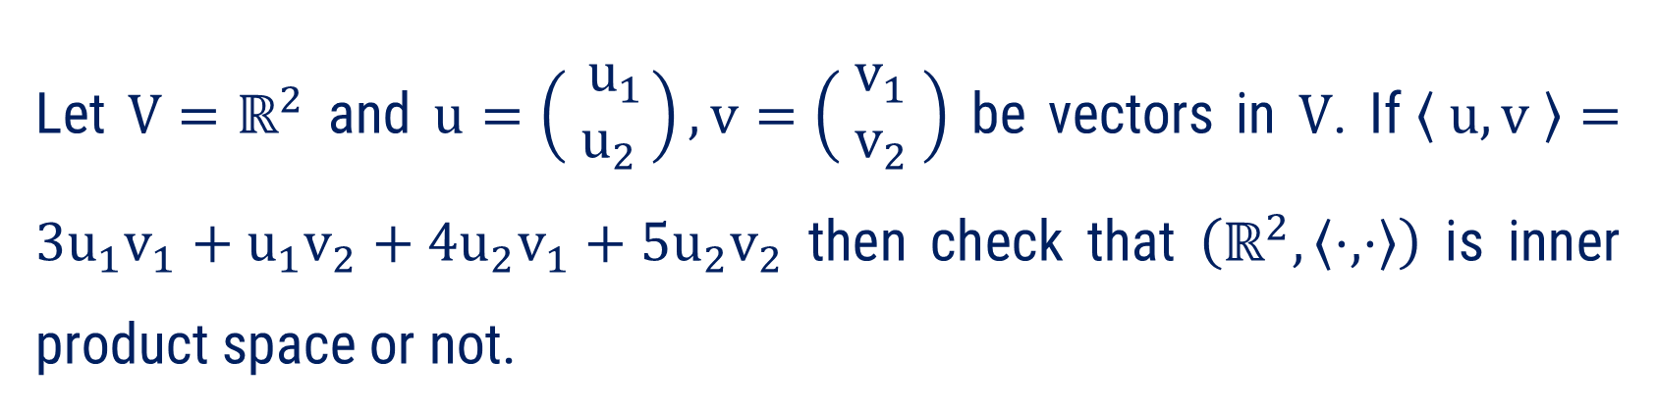





Method:1 $⇝$ Example:2
Let $V=ℝ^{2}$ and $u=\left( \begin{matrix}u_{1} \\ u_{2} \end{matrix}\right), v=\left( \begin{matrix}v_{1} \\ v_{2}\end{matrix} \right)$ be vectors in $V$. If$〈 u,v 〉=3u_{1}v_{1}+u_{1}v_{2}+4u_{2}v_{1}+5u_{2}v_{2}$ then check that $\left(ℝ^{2},〈⋅,⋅〉\right)$ is inner product space or not.
Example
Let, $u=\left( \begin{matrix}u_{1} \\ u_{2}\end{matrix}\right),v=\left( \begin{matrix}v_{1} \\ v_{2}\end{matrix} \right),w=\left( \begin{matrix}w_{1} \\ w_{2}\end{matrix} \right)∈ℝ^{2}$ and $k∈ℝ$
Solution
Axiom 1: $⟨ u, v ⟩=⟨ v, u ⟩$
Now, $⟨ u, v ⟩=3u_{1}v_{1}+u_{1}v_{2}+4u_{2}v_{1}+5u_{2}v_{2}$
Now, $⟨ v, u ⟩$
$$=3v_{1}u_{1}+v_{1}u_{2}+4v_{2}u_{1}+5u_{2}v_{2}$$
So, $\left\langle u, v \right\rangle ≠\left\langle v, u \right\rangle ;$for some $u$ & $v$.
Hence, $\left(ℝ^{2},〈⋅,⋅〉\right)$ is not a IPS.

Slide 16
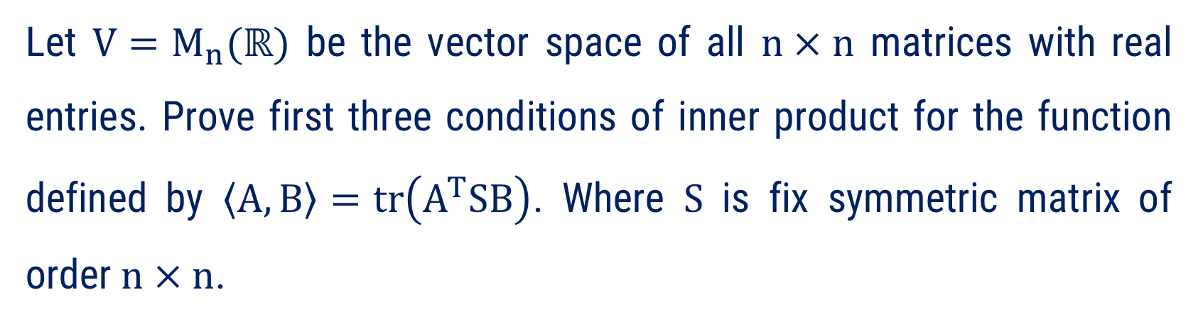
Method:1 $⇝$ Example:3
Example
Let $V=M_{n}(ℝ)$ be the vector space of all $n×n$ matrices with real entries. Prove first three conditions of inner product for the function defined by $\left\langle A, B\right\rangle =tr\left(A^{T}SB\right)$. Where $S$ is fix symmetric matrix of order $n×n$.
Solution
Let, $A, B$ and $C∈M_{n}(ℝ)$ and $k∈ℝ$

Slide 17


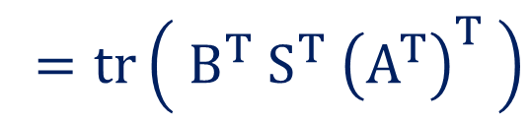
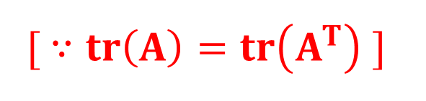
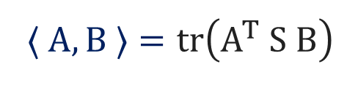



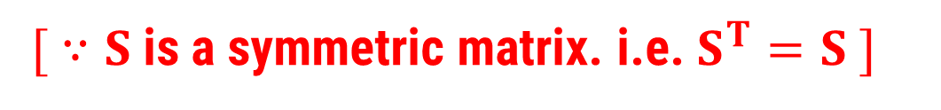
Method:1 $⇝$ Example:3(continue)
Axiom 1: $⟨ A, B ⟩=⟨ B, A ⟩$
$$⟨ A, B ⟩=tr\left(A^{T} S B\right)$$
Now, $⟨ A, B ⟩=tr\left(A^{T} S B\right)$
$$=tr\left[{\left(A^{T} S B\right)}^{T}\right]$$
$$[ ∵tr\left(A\right)=tr\left(A^{T}\right) ]$$
$$=tr\left( B^{T} S^{T} {\left(A^{T}\right)}^{T} \right)$$
$$=tr \left( B^{T} S A \right)$$
$[ ∵S$ is a symmetric matrix. i.e.$S^{T}=S ]$
$$=⟨ B, A ⟩$$

Slide 18




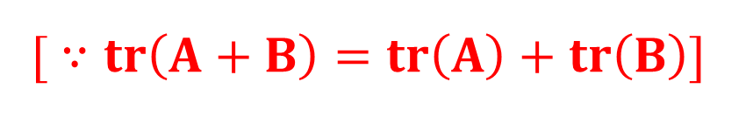

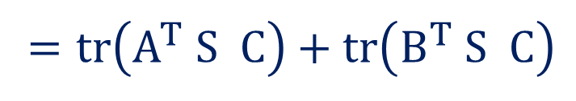

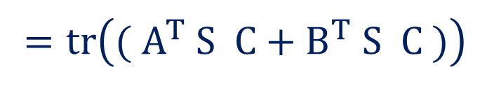

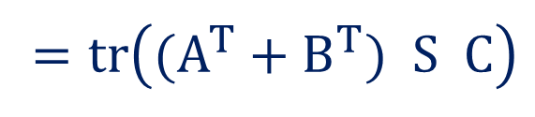

Method:1 $⇝$ Example:3(continue)
Axiom 2: $〈 A+B, C 〉=〈 A, C 〉+〈 B,C 〉$
$$⟨ A, B ⟩=tr\left(A^{T} S B\right)$$
Now, $⟨ A+B, C ⟩=$
$$tr\left({\left(A+B\right)}^{T} S C\right)$$
$${\left(A+B\right)}^{T}$$
$$C$$
$$S$$
$$=tr\left((A^{T}+B^{T}) S C\right)$$
$$=tr\left(( A^{T} S C+B^{T} S C )\right)$$
$$=tr\left(A^{T} S C\right)+tr\left(B^{T} S C\right)$$
$$[ ∵tr\left(A+B\right)=tr\left(A\right)+tr\left(B\right)]$$
$$=⟨ A, C ⟩$$
$$+ ⟨ B, C ⟩$$

Slide 19


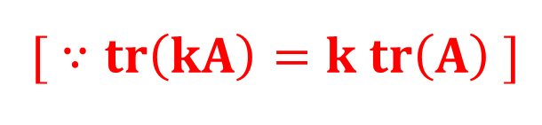
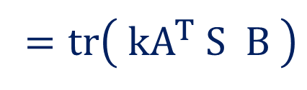
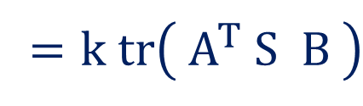


Method:1 $⇝$ Example:3(continue)
Axiom 3: $〈 kA, B 〉=k〈 A, B 〉$
$$⟨ A, B ⟩=tr\left(A^{T} S B\right)$$
Now, $⟨ kA, B ⟩=$
$$tr\left({\left(kA\right)}^{T} S B\right)$$
$$=tr\left( kA^{T} S B \right)$$
$$=k tr\left( A^{T} S B \right)$$
$$[ ∵tr\left(kA\right)=k tr\left(A\right) ]$$
$$=k ⟨ A, B ⟩$$
Hence, First three axioms for IPS on $M_{n}(ℝ)$ are satisfied.

Slide 20
Method-2
Properties of Inner Product and Norm

Slide 21
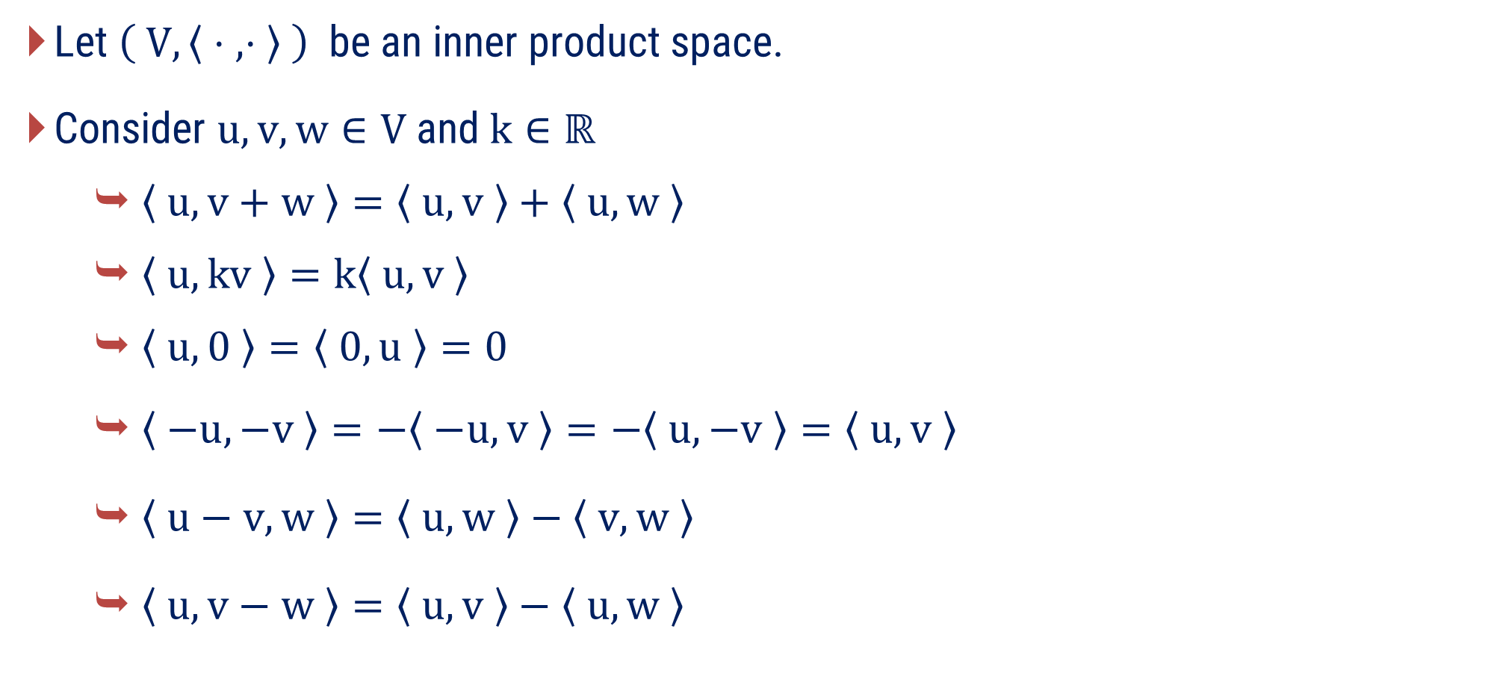
Properties of Inner Product Space
Let $\left( V, 〈 ⋅ , ⋅ 〉 \right)$ be an inner product space.
Consider $u, v, w∈V \text{and} k∈ℝ$
  $〈 u, v+w 〉=〈 u, v 〉+〈 u, w 〉$
  $〈 u, kv 〉=k〈 u, v 〉$
  $〈 u,0 〉=〈 0,u 〉=0$
  $〈 −u, −v 〉=−〈 −u, v 〉=−〈 u, −v 〉=〈 u, v 〉$
  $〈 u−v, w 〉=〈 u, w 〉−〈 v, w 〉$
  $〈 u,v−w 〉=〈 u, v 〉−〈 u, w 〉$

Slide 22
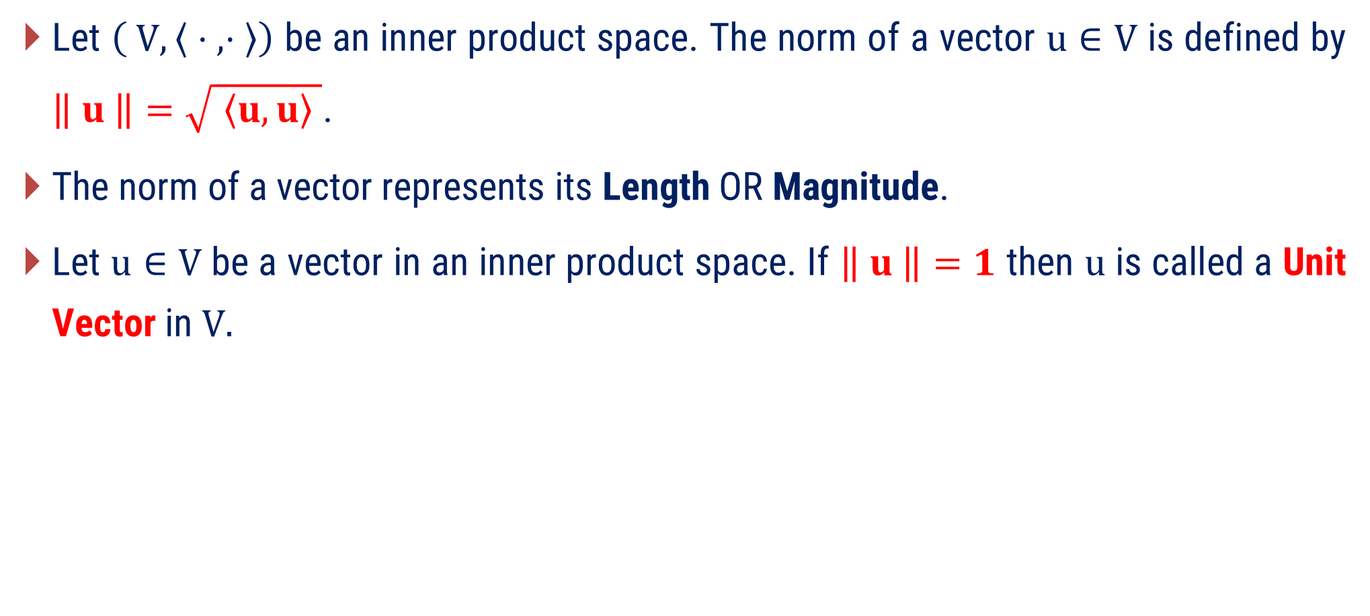
Norm
Let $\left( V, 〈 ⋅ , ⋅ 〉\right)$ be an inner product space. The norm of a vector $u∈V$ is defined by $\left\| u \right\|=\sqrt{ 〈u,u〉 }$.
The norm of a vector represents its Length OR Magnitude.
Let $u∈V$ be a vector in an inner product space. If $\left\| u \right\|=1$ then $u$ is called a Unit Vector in $V.$

Slide 23
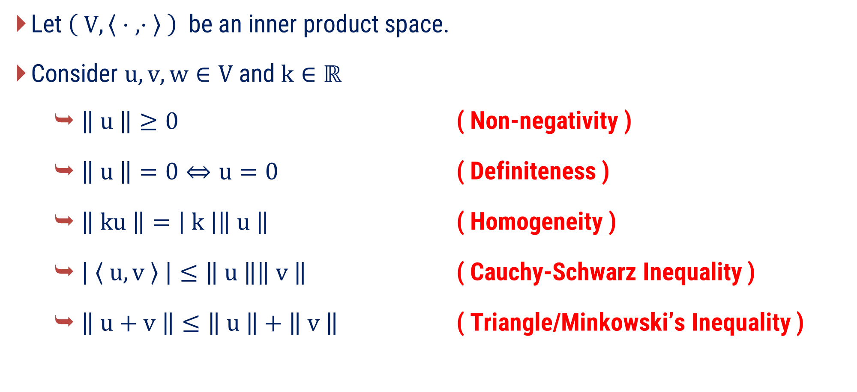
Properties of Norm
Let $\left( V, 〈 ⋅ , ⋅ 〉 \right)$ be an inner product space.
Consider $u, v, w∈V \text{and} k∈ℝ$
  $\left\| u \right\|≥0$ ( Non-negativity )
  $\left\| u \right\|=0⇔u=0$ ( Definiteness )
  $\left\| ku \right\|=\left| k \right|\left\| u \right\|$ ( Homogeneity )
  $\left| 〈 u, v 〉 \right|≤\left\| u \right\|\left\| v \right\|$ ( Cauchy-Schwarz Inequality )
  $\left\| u+v \right\|≤\left\| u \right\|+\left\| v \right\|$ ( Triangle/Minkowski’s Inequality )

Slide 24
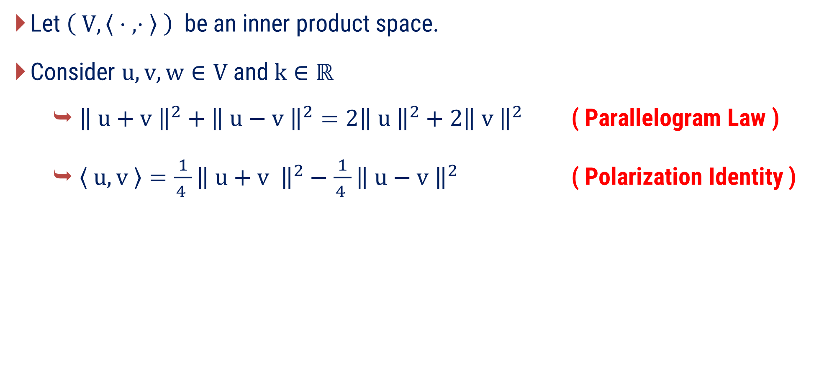
Properties of Norm
Let $\left( V, 〈 ⋅ , ⋅ 〉 \right)$ be an inner product space.
Consider $u, v, w∈V$and$k∈ℝ$
  ${\left\| u+v \right\|}^{2}+{\left\| u−v \right\|}^{2}={2\left\| u \right\|}^{2}+2{\left\| v \right\|}^{2}$ ( Parallelogram Law )
  $〈 u,v 〉=\frac{ 1 }{4 }{\left\| u+v \right\|}^{2}−\frac{ 1 }{4 }{\left\| u−v \right\|}^{2}$ ( Polarization Identity )

Slide 25
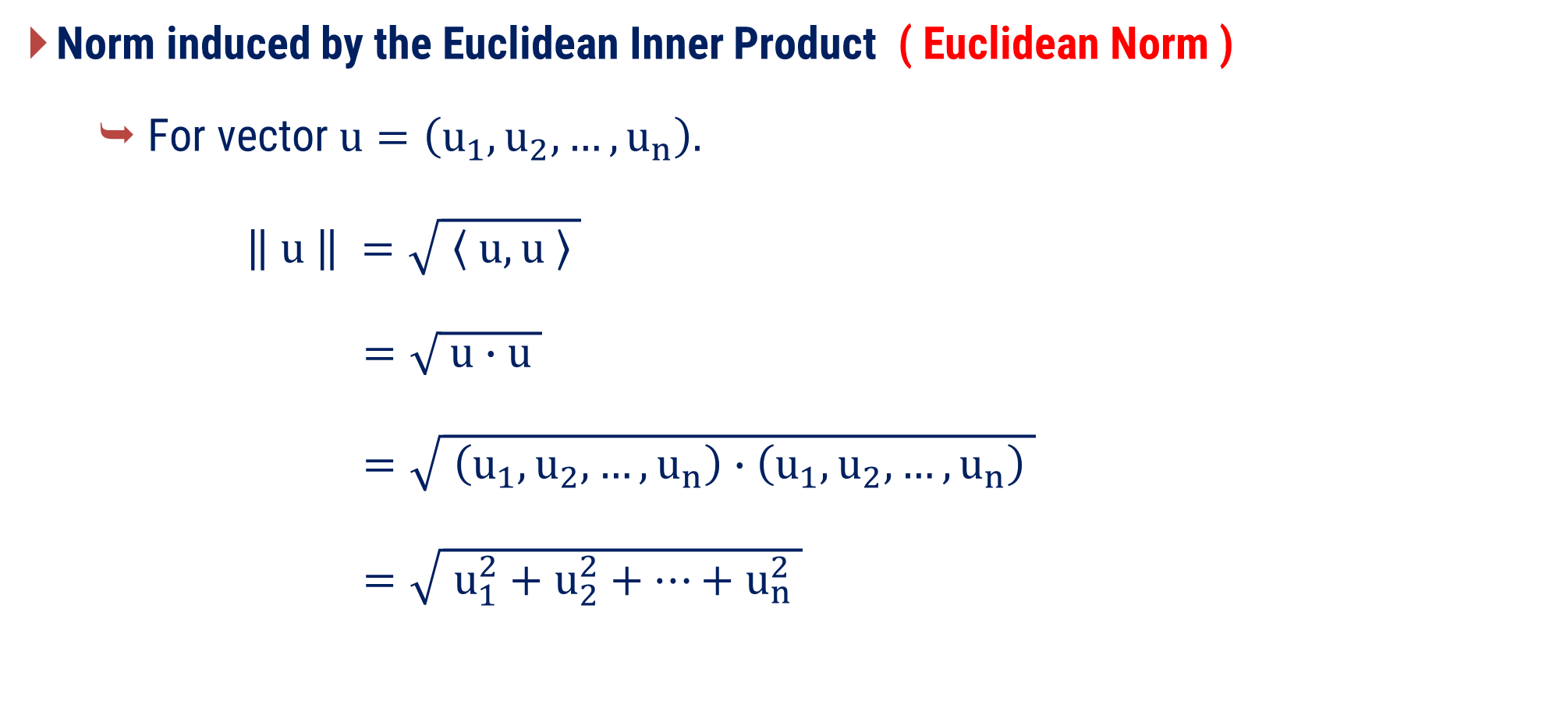
Norm induced by the different inner product
Norm induced by the Euclidean Inner Product ( Euclidean Norm )
  For vector $u=\left(u_{1},u_{2},…,u_{n}\right).$
$\left\| u \right\| =\sqrt{ 〈 u, u 〉 }$
$=\sqrt{ u∙u }$
$=\sqrt{ \left(u_{1},u_{2},…,u_{n}\right)∙\left(u_{1},u_{2},…,u_{n}\right) }$
$=\sqrt{ u_{1}^{2}+u_{2}^{2}+…+u_{n}^{2} }$

Slide 26
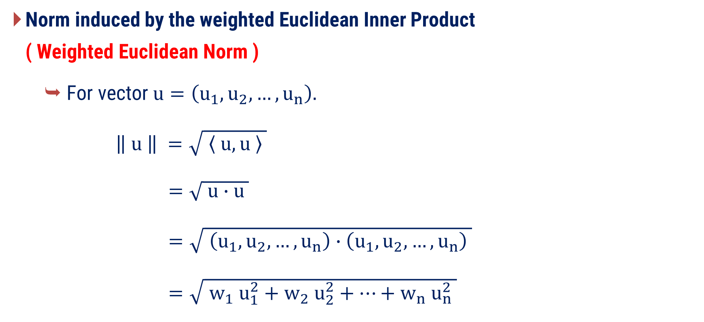
Norm induced by the different inner product
Norm induced by the weighted Euclidean Inner Product ( Weighted Euclidean Norm )
  For vector $u=\left(u_{1},u_{2},…,u_{n}\right).$
$\left\| u \right\| =\sqrt{ 〈 u, u 〉 }$
$=\sqrt{ u∙u }$
$=\sqrt{ \left(u_{1},u_{2},…,u_{n}\right)∙\left(u_{1},u_{2},…,u_{n}\right) }$
$=\sqrt{ w_{1} u_{1}^{2}+w_{2} u_{2}^{2}+…+w_{n} u_{n}^{2} }$

Slide 27
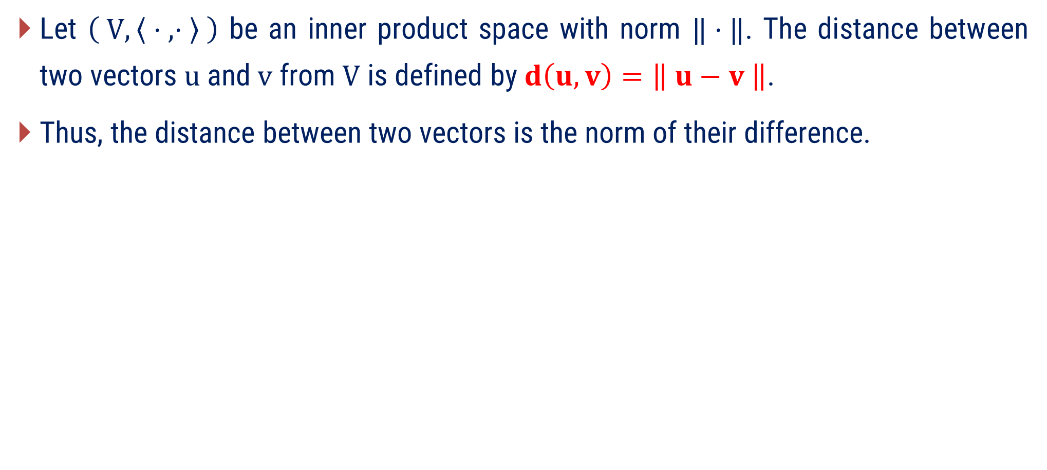
Distance
Let $\left( V, 〈 ⋅ , ⋅ 〉 \right)$ be an inner product space with norm $‖⋅‖$. The distance between two vectors $u$ and $v$ from $V$ is defined by $d\left(u, v\right)=\left\| u−v \right\|$.
Thus, the distance between two vectors is the norm of their difference.

Slide 28
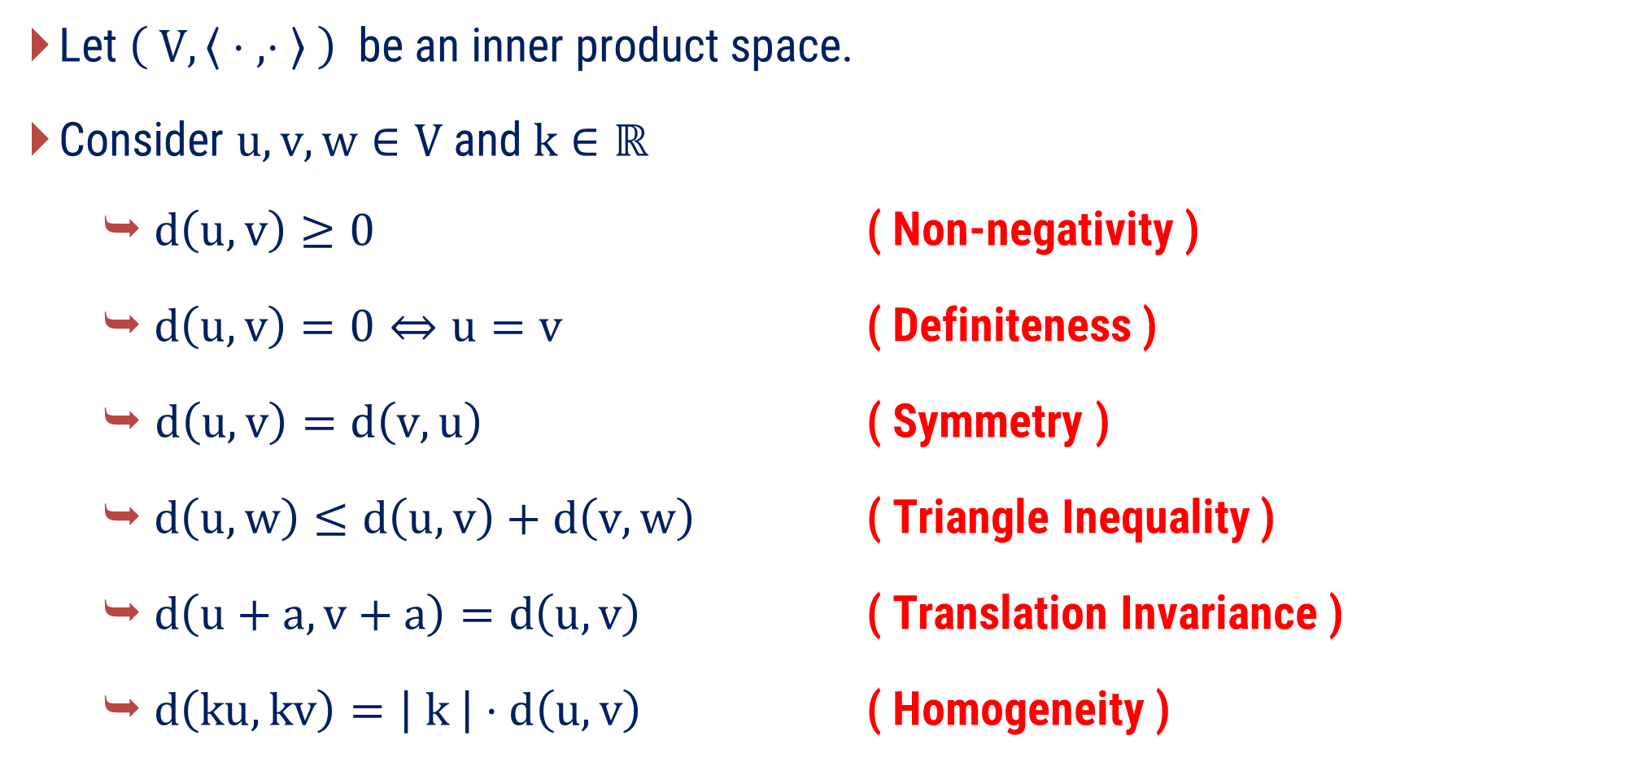
Properties of Distance
Let $\left( V, 〈 ⋅ , ⋅ 〉 \right)$ be an inner product space.
Consider $u, v, w∈V$and$k∈ℝ$
  $d\left(u, v\right)≥0$ ( Non-negativity )
  $d\left(u, v\right)=0⇔u=v$ ( Definiteness )
  $d\left(u, v\right)=d\left(v, u\right)$ ( Symmetry )
  $d\left(u, w\right)≤d\left(u, v\right)+d\left(v, w\right)$ ( Triangle Inequality )
  $d\left(u+a, v+a\right)=d\left(u, v\right)$ ( Translation Invariance )
  $d\left(ku, kv\right)=\left| k \right|⋅d\left(u, v\right)$ ( Homogeneity )

Slide 29
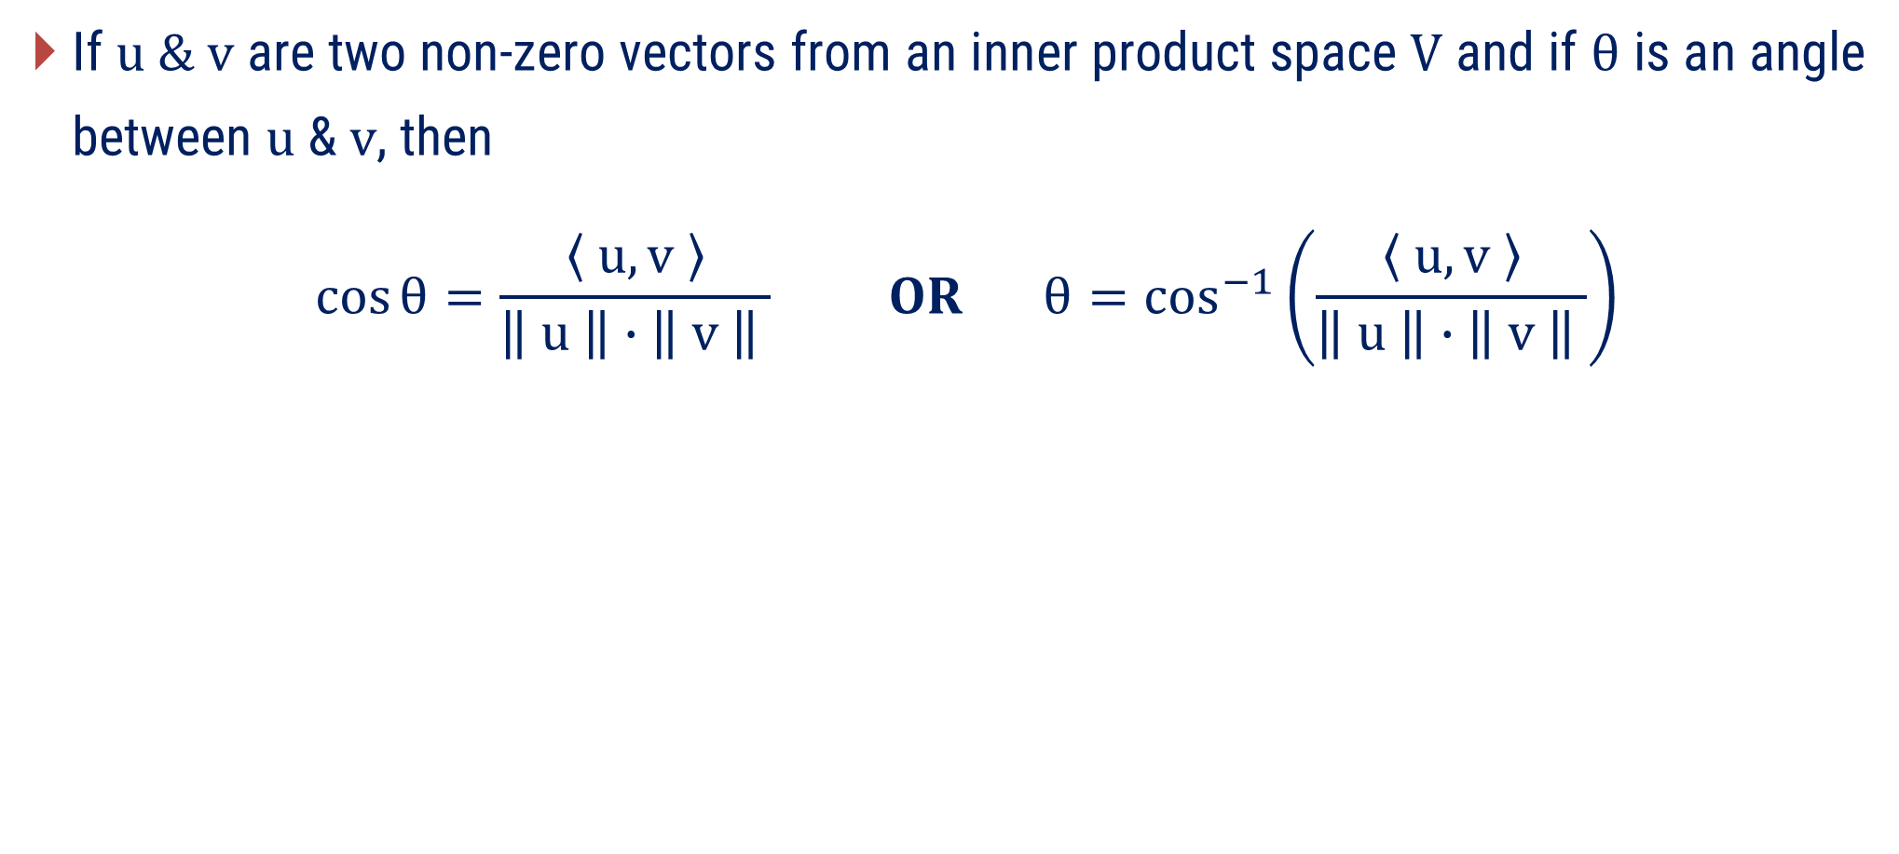
Angle between two vectors $u \& v$
If $u \& v$ are two non-zero vectors from an inner product space $V$ and if $θ$ is an angle between $u$ & $v$, then
$$\cos{θ=\frac{ 〈 u,v 〉 }{\left\| u \right\|∙\left\| v \right\| }} OR θ{=\cos^{−1}\left(\frac{ 〈 u,v 〉 }{\left\| u \right\|∙\left\| v \right\| }\right)}$$

Slide 30
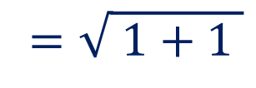
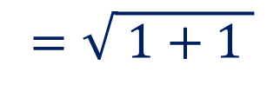
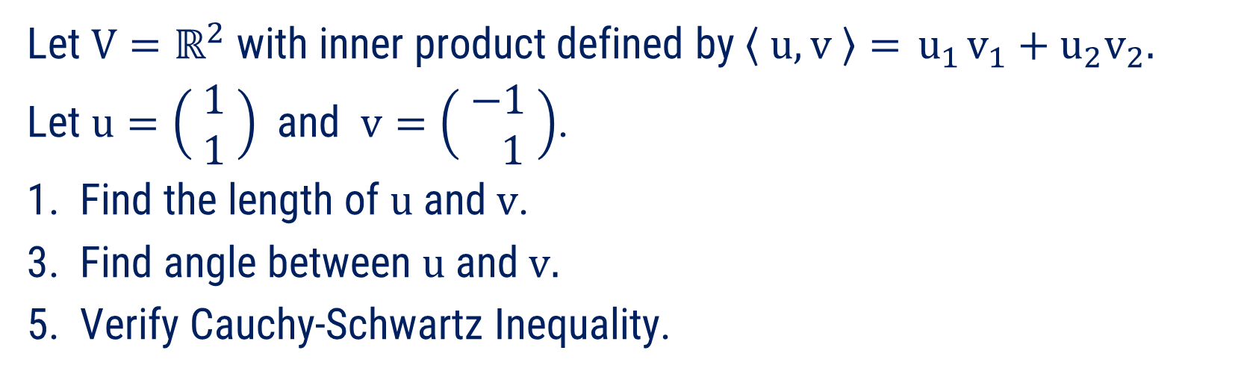
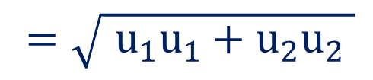
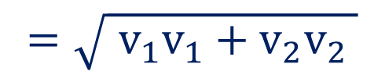
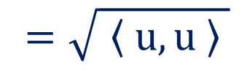
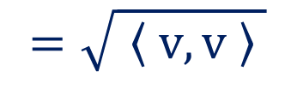


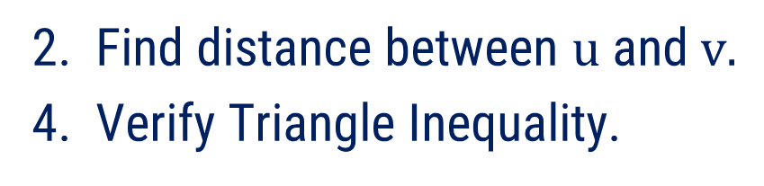
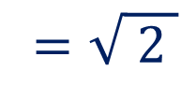
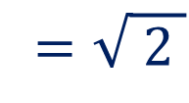
Method:2 $⇝$ Example:1
Example
Let $V=ℝ^{2}$ with inner product defined by $〈 u, v 〉={ u}_{1}v_{1}+u_{2}v_{2}.$
Let $u=\left( \begin{matrix}1 \\ 1\end{matrix} \right)$ and $v=\left( \begin{matrix}−1 \\ 1\end{matrix} \right)$.
1. Find the length of $u$and$v$.
3. Find angle between $u$and$v.$
5. Verify Cauchy-Schwartz Inequality.
2. Find distance between $u$and$v.$
4. Verify Triangle Inequality.
Solution
1. Find the length of u and v.
$$=\sqrt{ 〈 u, u 〉 }$$
$$=\sqrt{{ u}_{1}u_{1}+u_{2}u_{2} }$$
$$=\sqrt{ 1+1 }$$
$$=\sqrt{ 2 }$$
Now, Length of $u$ $= \left\| u \right\|$
$$=\sqrt{ 〈 v, v 〉 }$$
$$=\sqrt{{ v}_{1}v_{1}+v_{2}v_{2} }$$
$$=\sqrt{ 1+1 }$$
$$=\sqrt{ 2 }$$
Now, Length of $v$ $= \left\| v \right\|$

Slide 31
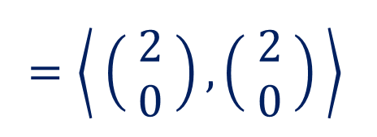
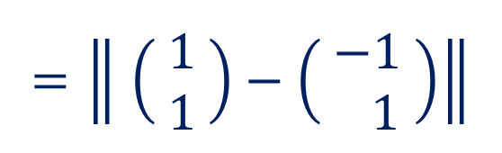

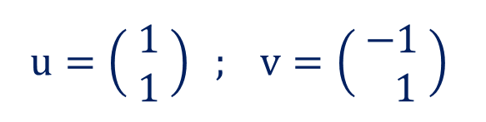

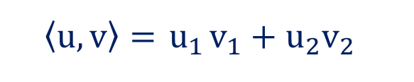

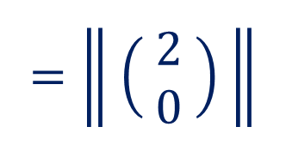



Method:2 $⇝$ Example:1(continue)
2. Find distance between $u$ and $v$.
$$〈u, v〉={ u}_{1}v_{1}+u_{2}v_{2}$$
Now, Distance between $u$ and $v$ $=\left\| u−v \right\|$
$$u=\left( \begin{matrix}1 \\ 1\end{matrix} \right) ; v=\left( \begin{matrix}−1 \\ 1\end{matrix} \right)$$
$$=\left\| \left( \begin{aligned}1 \\ 1\end{aligned} \right)−\left( \begin{aligned}−1 \\ 1\end{aligned} \right)\right\|$$
$$=\left\| \left( \begin{aligned}2 \\ 0\end{aligned} \right) \right\|$$
$$[ ∵\left\| u \right\|=\sqrt{ 〈 u, u 〉 } ]$$
$$=\left\langle \left( \begin{aligned}2 \\ 0\end{aligned} \right),\left( \begin{aligned}2 \\ 0\end{aligned} \right) \right\rangle$$
$$=\sqrt{ \left(2\right)\left(2\right)+\left(0\right)\left(0\right)}$$
$$⇒d\left(u, v\right)$$
$$=2$$

Slide 32

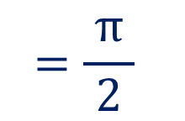

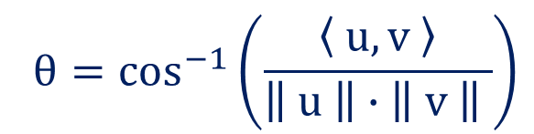
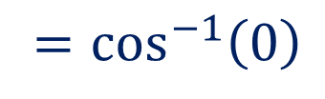






Method:2 $⇝$ Example:1(continue)
3. Find angle between $u$ and $v$.
$$〈u, v〉={ u}_{1}v_{1}+u_{2}v_{2}$$
Since, $\left\| u \right\|=\sqrt{ 2 }$ and $\left\| v \right\|=\sqrt{ 2 }$.
$[$ From Que. 1 $]$
$$u=\left( \begin{matrix}1 \\ 1\end{matrix} \right) ; v=\left( \begin{matrix}−1 \\ 1\end{matrix} \right)$$
Now, $〈 u, v 〉={ u}_{1}v_{1}+u_{2}v_{2}$
$$θ{=\cos^{−1}\left(\frac{ 〈 u,v 〉 }{\left\| u \right\|∙\left\| v \right\| }\right)}$$
$$=\left(1\right)\left(−1\right)+\left(1\right)\left(1\right)$$
$$=0$$
Now, $θ{=\cos^{−1}\left(\frac{ 〈 u,v 〉 }{\left\| u \right\|∙\left\| v \right\| }\right)}$
$$=\cos^{−1}\left(0\right)$$
$$[ ∵〈 u, v 〉=0 ]$$
$$=\frac{ π }{2}$$

Slide 33
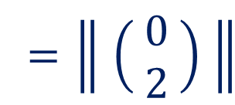
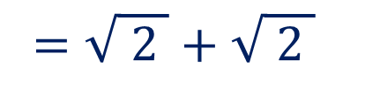


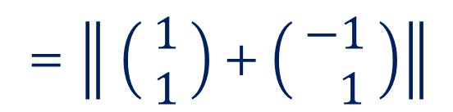









Method:2 $⇝$ Example:1(continue)
4. Verify Triangle Inequality.
$$〈u, v〉={ u}_{1}v_{1}+u_{2}v_{2}$$
Now, $\left\| u+v \right\|$
$$=\left\| \left( \begin{aligned}1 \\ 1\end{aligned} \right)+\left( \begin{aligned}−1 \\ 1\end{aligned} \right)\right\|$$
$$u=\left( \begin{matrix}1 \\ 1\end{matrix} \right) ; v=\left( \begin{matrix}−1 \\ 1\end{matrix} \right)$$
$$=\left\| \left( \begin{aligned}0 \\ 2\end{aligned} \right) \right\|$$
$$\left\| u+v \right\|≤\left\| u \right\|+\left\| v \right\|$$
$$=\left\langle \left( \begin{aligned}0 \\ 2\end{aligned} \right),\left( \begin{aligned}0 \\ 2\end{aligned} \right) \right\rangle$$
$$\left\| u \right\|=\sqrt{ 2 } ,\left\| v \right\|=\sqrt{ 2 }$$
$$=\sqrt{ \left(0\right)\left(0\right)+\left(2\right)\left(2\right)}$$
$$=2$$
$$…\left( 1 \right)$$
Now, $\left\| u \right\|+\left\| v \right\|$
$$=\sqrt{ 2 }+\sqrt{ 2 }$$
$$=2\sqrt{ 2 }$$
$$…\left( 2 \right)$$
From Eq ($1$) & ($2$), $\left\| u+v \right\|≤\left\| u \right\|+\left\| v \right\|$.
Hence verified.

Slide 34












Method:2 $⇝$ Example:1(continue)
5. Verify Cauchy-Schwartz Inequality.
$$〈u, v〉={ u}_{1}v_{1}+u_{2}v_{2}$$
Now, $\left| 〈 u, v 〉 \right|$
$$=0$$
$$…\left( 1 \right)$$
$$u=\left( \begin{matrix}1 \\ 1\end{matrix} \right) ; v=\left( \begin{matrix}−1 \\ 1\end{matrix} \right)$$
Now, $\left\| u \right\| \left\| v \right\|$
$$=\sqrt{ 2 } \sqrt{ 2 }$$
$$=2$$
$$…\left( 2 \right)$$
$$\left| 〈 u, v 〉 \right|≤\left\| u \right\|\left\| v \right\|$$
From Eq ($1$) & ($2$), $\left| 〈 u, v 〉 \right|≤\left\| u \right\| \left\| v \right\|$.
$$〈 u, v 〉=0$$
Hence verified.
$$\left\| u \right\|=\sqrt{ 2 } ,\left\| v \right\|=\sqrt{ 2 }$$

Slide 35






Method:2 $⇝$ Example:2
Example
Let the vector space $ℙ_{2}$ have the inner product
$$〈 p,q 〉=\int_{−1}^{1}{p\left(x\right) q\left(x\right) dx}.$$
Find$\left\| p \right\|$for$p=x^{2}$and find$d\left(p,q\right)$if$p=1$and$q=x.$
Solution
$$=\sqrt{\int_{−1}^{1}{p\left(x\right) p\left(x\right) dx }}$$
Now, $\left\| p \right\|$
$$=\sqrt{ 〈 p, p 〉 }$$
$$=\sqrt{\int_{−1}^{1}{x^{2} x^{2} dx} }$$
$[$Given that, $p=x^{2} ]$

Slide 36




Method:2 $⇝$ Example:2(continue)
$$=\sqrt{\int_{−1}^{1}{x^{4} dx} }$$
$$=\sqrt{{ \left[ \frac{ x^{5} }{5} \right]}_{−1}^{ 1}}$$
$$=\sqrt{ \frac{ 2 }{5} }$$
$$⇒\left\| p \right\|$$

Slide 37











Method:2 $⇝$ Example:2(continue)
$$=\sqrt{ \frac{ {\left(1−1\right)}^{3} }{\left(−1\right)3}−\frac{ {\left(1−1\right)}^{3} }{\left(−1\right)3} }$$
Now, $d\left( p,q \right)$
$$=\left\| p−q \right\|$$
$$\frac{ {\left(1−1\right)}^{3} }{\left(−1\right)3}$$
$$−\frac{ {\left(1+1\right)}^{3} }{\left(−1\right)3}$$
$$=\left\| 1−x \right\|$$
$$=\sqrt{ 0+\frac{8}{ 3 } }$$
$$=\sqrt{〈 1−x,1−x 〉 }$$
$$=\sqrt{\int_{−1}^{1}{\left(1−x\right)\left(1−x\right) dx} }$$
$$⇒d\left(p, q\right)=\sqrt{ \frac{8}{ 3 } }$$
$$=\sqrt{{ \left[ \frac{ {\left(1−x\right)}^{3} }{\left(−1\right)3} \right]}_{−1}^{ 1} }$$

Slide 38












Method:2 $⇝$ Example:3
Verify Parallelogram law for $\left[\begin{matrix}−1 & 2 \\ 6 & 1\end{matrix} \right]$ and $\left[ \begin{matrix}1 & 0 \\ 3 & 2\end{matrix} \right]$ under the Euclidean inner product on $𝕄_{22.}$
Example
Let $A=\left[\begin{matrix}−1 & 2 \\ 6 & 1\end{matrix} \right]$ and $B=\left[ \begin{matrix}1 & 0 \\ 3 & 2\end{matrix} \right]$
Solution
Parallelogram Law: ${\left\| A+B \right\|}^{2}+{\left\| A−B \right\|}^{2}={2\left\| A \right\|}^{2}+2{\left\| B \right\|}^{2}$
Now, ${\left\| A \right\|}^{2}=$
$${\left(−1\right)}^{2}+{\left(2\right)}^{2}+{\left(6\right)}^{2}+{\left(1\right)}^{2}$$
$$=42$$
Now, ${\left\| B \right\|}^{2}=$
$${\left(1\right)}^{2}+{\left(0\right)}^{2}+{\left(3\right)}^{2}+{\left(2\right)}^{2}$$
$$=14$$
Now, $2{\left\| A \right\|}^{2}+2{\left\| B \right\|}^{2}=$
$$2\left(42\right)+2\left(14\right)$$
$$=112$$
$$…\left( 1 \right)$$

Slide 39















Method:2 $⇝$ Example:3(continue)
$$\left[ \begin{matrix}0 & 2 \\ 9 & 3\end{matrix} \right]$$
$$A=\left[\begin{matrix}−1 & 2 \\ 6 & 1\end{matrix} \right] \text{;} B=\left[ \begin{matrix}1 & 0 \\ 3 & 2\end{matrix} \right]$$
Now, $A+B=$
Now, $A−B=$
$$\left[ \begin{matrix}−2 & 2 \\ 3 & −1\end{matrix} \right]$$
$$2{\left\| A \right\|}^{2}+2{\left\| B \right\|}^{2}=112$$
Now,${ \left\| A+B \right\|}^{2} =$
$${\left(0\right)}^{2}+{\left(2\right)}^{2}+{\left(9\right)}^{2}+{\left(3\right)}^{2}$$
$$=94$$
Now,${ \left\| A−B \right\|}^{2} =$
$${\left(−2\right)}^{2}+{\left(2\right)}^{2}+{\left(3\right)}^{2}+{\left(−1\right)}^{2}$$
$$=18$$
Now,${{ \left\| A+B \right\|}^{2}+\left\| A−B \right\|}^{2} =$
$$94+18=112$$
$$…\left( 2 \right)$$
From Eq ($1$) & ($2$),${{ \left\| A+B \right\|}^{2}+\left\| A−B \right\|}^{2}=2{\left\| A \right\|}^{2}+2{\left\| B \right\|}^{2}$
Hence, Parallelogram Law is verified.

Slide 40






Method:2 $⇝$ Example:4
Example
Let V be an inner product space. For $u,v∈V$ prove that
$$〈 u,v 〉=\frac{ 1 }{4 }{\left\| u+v \right\|}^{2}−\frac{ 1 }{4 }{\left\| u−v \right\|}^{2} \left(Polarization Identity\right).$$
Solution
Since, ${\left\| u \right\|}^{2}=〈 u,u 〉$
Now, ${\left\| u+v \right\|}^{2}=〈 u+v,u+v 〉$
$$=〈 u,u+v 〉+〈 v,u+v 〉$$
$$=〈 u,u 〉+〈 u,v 〉+〈 v,u 〉+〈 v,v 〉$$
$$={\left\| u \right\|}^{2}+2〈 u,v 〉+{\left\| v \right\|}^{2}$$
Now, ${\left\| u−v \right\|}^{2}={\left\| u \right\|}^{2}−2〈 u,v 〉+{\left\| v \right\|}^{2}$

Slide 41







Method:2 $⇝$ Example:4(continue)
Now,
$$\frac{ 1 }{ 4 }{\left\| u+v \right\|}^{2}−\frac{ 1 }{ 4 }{\left\| u−v \right\|}^{2}$$
$${\left\| u+v \right\|}^{2}={\left\| u \right\|}^{2}+2〈 u,v 〉+{\left\| v \right\|}^{2}$$
$${\left\| u−v \right\|}^{2}={\left\| u \right\|}^{2}−2〈 u,v 〉+{\left\| v \right\|}^{2}$$
$$=\frac{ 1 }{ 4 }\left[ {\left\| u \right\|}^{2}+2〈 u,v 〉+{\left\| v \right\|}^{2} \right]$$
$$−\frac{ 1 }{ 4 }\left[ {\left\| u \right\|}^{2}−2〈 u,v 〉+{\left\| v \right\|}^{2} \right]$$
$$=\frac{ 1 }{ 2 }〈 u,v 〉+\frac{ 1 }{ 2 }〈 u,v 〉$$
$$=〈 u,v 〉$$
Hence, $〈 u,v 〉=\frac{ 1 }{4 }{\left\| u+v \right\|}^{2}−\frac{ 1 }{4 }{\left\| u−v \right\|}^{2}$ is proved.

Slide 42
Method-3
Orthogonal and Orthonormal Sets

Slide 43





Orthogonal Vectors
Two vectors $u$&$v$ are said to be orthogonal when they are perpendicular $\left(θ=\frac{ π }{ 2 }\right)$.
  Since, Angle between two vectors is
  If $u$ and $v$ are orthogonal vector, then $〈u,v〉=0$.
If any two non-zero vectors are orthogonal, then they are LI.
$$\cos{θ}=\frac{ 〈 u,v 〉 }{\left\| u \right\|∙\left\| v \right\| }$$
$$⇒\cos{\frac{ π }{ 2 }}=\frac{ 〈 u,v 〉 }{\left\| u \right\|∙\left\| v \right\| }$$
$$⇒0=\frac{ 〈 u,v 〉 }{\left\| u \right\|∙\left\| v \right\| }$$
$$⇒0=〈 u,v 〉$$

Slide 44

Orthonormal Vectors
Two vectors $u$&$v$ are said to be orthonormal when they are unit and perpendicular.
  If $u$ and $v$ are orthonormal vector, then $\left\| u \right\|=\left\| v \right\|=1$ and $〈u,v〉=0$.
If any two non-zero vectors are orthonormal, then they are LI.

Slide 45

Orthogonal and Orthonormal Set
Orthogonal Set
  A set $S=\{u_{1},u_{2},…,u_{n}\}$ of vectors in an inner product space $V$ is called an orthogonal set if each pair of distinct vectors in $S$ are orthogonal.
  i.e., $〈 u_{i},u_{j} 〉=0 ; i≠j$
Orthonormal Set
  A orthogonal set $S=\{u_{1},u_{2},…,u_{n}\}$ with unit vectors is called orthonormal set.
  i.e., $〈 u_{i},u_{j} 〉=0 ; i≠j$ and $〈u_{i},u_{i}〉 =1 for i=1,2,…,n$

Slide 46

Orthogonal and Orthonormal Set
Remarks:
  Any orthogonal set of $n$–non zero vectors in $ℝ^{n}$ is a basis for $ℝ^{n}.$
  In an inner product space, a basis contains orthogonal vector is called orthogonal basis.
  In an inner product space, a basis contains orthonormal vector is called orthonormal basis.
  Pythagoras Theorem: The vectors $u and v$ are orthogonal (perpendicular) vectors in a real inner product space $V$ if and only if
  $${\left\| u+v \right\|}^{2}={\left\| u \right\|}^{2}+{\left\| v \right\|}^{2}$$

Slide 47

Orthogonal and Orthonormal Set
Remarks:
  If $u$ is any nonzero vector then the unit vector in the direction of $u$ is given by
  $\hat{ u }=\frac{ u }{ \left\| u \right\| }$
  The process of dividing non-zero vector $u$ by its norm is called normalizing$u$.

Slide 48







Method:3 $⇝$ Example:1
Example
Determine whether the given vectors are orthogonal with respect to the Euclidean inner product
$$\text{1.} u=\left(−\begin{matrix}1, & 3, & 2\end{matrix}\right) \text{and} v=\left(\begin{matrix}4, & 2, & −1\end{matrix}\right)$$
$$\text{2. } u=\left(\begin{matrix}\begin{matrix}−4, & 6,\end{matrix} & \begin{matrix}−10, & 1\end{matrix}\end{matrix}\right) \text{and} v=\left(\begin{matrix}\begin{matrix}2, & 1,\end{matrix} & −\begin{matrix}2, & 9\end{matrix}\end{matrix}\right)$$
Solution
We know that, Euclidean Inner Product $〈 u,v 〉=u⋅v$
$u$ and $v$ are orthogonal vector if, $〈 u,v 〉=0$
1. $u=\left(−\begin{matrix}1, & 3, & 2\end{matrix}\right) \text{and} v=\left(\begin{matrix}4, & 2, & −1\end{matrix}\right)$
Now, $〈 u,v 〉=u⋅v$
$$=\left(−\begin{matrix}1, & 3, & 2\end{matrix}\right) ⋅\left(\begin{matrix}4, & 2, & −1\end{matrix}\right)$$
$$=−4+6−2$$
$$=0$$
Hence, $u=\left(−\begin{matrix}1, & 3, & 2\end{matrix}\right) \text{and} v=\left(\begin{matrix}4, & 2, & −1\end{matrix}\right)$ are orthogonal vectors.

Slide 49




Method:3 $⇝$ Example:1(continue)
2. $u=\left(\begin{matrix}\begin{matrix}−4, & 6,\end{matrix} & \begin{matrix}−10, & 1\end{matrix}\end{matrix}\right) \text{and} v=\left(\begin{matrix}\begin{matrix}2, & 1,\end{matrix} & −\begin{matrix}2, & 9\end{matrix}\end{matrix}\right)$
Now, $〈 u,v 〉=u⋅v$
$$=\left(\begin{matrix}\begin{matrix}−4, & 6,\end{matrix} & \begin{matrix}−10, & 1\end{matrix}\end{matrix}\right)⋅\left(\begin{matrix}\begin{matrix}2, & 1,\end{matrix} & −\begin{matrix}2, & 9\end{matrix}\end{matrix}\right)$$
$$=−8+6+20+9$$
$$=27≠0$$
Hence, $u=\left(\begin{matrix}\begin{matrix}−4, & 6,\end{matrix} & \begin{matrix}−10, & 1\end{matrix}\end{matrix}\right) \text{and} v=\left(\begin{matrix}\begin{matrix}2, & 1,\end{matrix} & −\begin{matrix}2, & 9\end{matrix}\end{matrix}\right)$ are not orthogonal vectors.

Slide 50

Method:3 $⇝$ Example:2
Example
For what values of a and b is the set {$u$, $v$} orthogonal with respect to the Euclidean inner product, where
$$u=\left(\frac{ 1 }{\sqrt{2 }}, 0, \frac{1 }{\sqrt{2 }}\right)\& v=\left(a, \frac{1 }{\sqrt{2 }},−b\right).$$
Solution
We know that, Euclidean Inner Product $〈 u,v 〉=u⋅v$
$u$ and $v$ are orthogonal vector if, $〈 u,v 〉=0$

Slide 51





Method:3 $⇝$ Example:2(continue)
$$u=\left(\frac{ 1 }{\sqrt{2 }}, 0, \frac{1 }{\sqrt{2 }}\right)$$
$$v=\left(a, \frac{1 }{\sqrt{2 }},−b\right)$$
Now, $〈 u,v 〉=u⋅v=0$
$$⇒\left(\frac{ 1 }{\sqrt{2 }}, 0, \frac{1 }{\sqrt{2 }}\right)⋅\left(a, \frac{1 }{\sqrt{2 }},−b\right)=0$$
$$⇒\frac{ a }{\sqrt{2 }}−\frac{b }{\sqrt{2 }}=0$$
$$⇒a=b$$

Slide 52











Method:3 $⇝$ Example:3
Example
Find two vectors in $ℝ^{2}$with Euclidean norm $1$ & whose Euclidean inner product with $\left(−3,1\right)$ is $0$.
Solution
Let $u=\left(x,y\right)∈ℝ^{2}$
We are given that $\left\| u \right\|=1$ and $u⋅\left(−3,1\right)=0$
Now, $\left\| u \right\|=1$
Now, $u⋅\left(−3,1\right)=0$
$$⇒\sqrt{ x^{2}+y^{2}}=1$$
$$⇒\left(x,y\right)⋅\left(−3,1\right)=0$$
$$⇒x^{2}+y^{2}=1$$
$$…\left( 1 \right)$$
$$⇒−3x+y=0$$
$$⇒y=3x$$
$$…\left( 2 \right)$$

Slide 53









Method:3 $⇝$ Example:3(continue)
Now, $x^{2}+y^{2}=1$
Now, $y=3x$
$$x^{2}+y^{2}=1$$
$$y=3x$$
$$⇒x^{2}+9x^{2}=1$$
$$⇒y=±\frac{3}{ \sqrt{ 10 } }$$
$$⇒10x^{2}=1$$
So, required two vectors
$$\left(\frac{1}{ \sqrt{ 10 } }, \frac{3}{ \sqrt{ 10 } }\right) \& \left(\frac{−1}{ \sqrt{ 10 } }, \frac{−3}{ \sqrt{ 10 } }\right)$$
$$⇒x^{2}=\frac{1}{ 10 }$$
$$⇒x=±\frac{1}{ \sqrt{ 10 } }$$

Slide 54




Method:3 $⇝$ Example:4
Example
For two vectors $a$ and b$,\left\| a+b \right\|=\left\| a−b \right\|.$ Find the angle between $a$ and $b$.
Solution
Now, $\left\| a+b \right\|=\left\| a−b \right\|$
$$⇒〈 a+b,a+b 〉=〈 a−b,a−b 〉$$
$$[ ∵\left\| u \right\|=\sqrt{ 〈 u, u 〉 } ]$$
$$⇒〈 a,a 〉+〈 b,a 〉+〈 a,b 〉+〈 b,b 〉$$
$$=〈 a,a 〉−〈 b,a 〉−〈 a,b 〉+〈 b,b 〉$$
$$[ ∵〈 u+v, w 〉=〈 u, w 〉+〈 v, w 〉]$$
$$⇒〈 b,a 〉+〈 a,b 〉=−〈 b,a 〉−〈 a,b 〉$$
$$⇒2〈 b,a 〉+2〈 a,b 〉=0$$

Slide 55






Method:3 $⇝$ Example:4(continue)
$$⇒2〈 b,a 〉+2〈 a,b 〉=0$$
$$⇒2〈 a,b 〉+2〈 a,b 〉=0$$
$$[ ∵〈 u, w 〉=〈 w, u 〉 ]$$
$$⇒〈 a,b 〉=0$$
So, vectors $a$ and $b$ are perpendicular.
Hence, angel between $a$ and $b$ is $\frac{ π }{2}.$

Slide 56

Orthogonal and Orthonormal Basis
Recall:
  Any orthogonal set of $n$–non zero vectors in $ℝ^{n}$ is a basis for $ℝ^{n}.$
  In an inner product space, a basis contains orthogonal vector is called orthogonal basis.
  In an inner product space, a basis contains orthonormal vector is called orthonormal basis.

Slide 57




Method:3 $⇝$ Example:5
Example
Find an orthogonal basis for $ℝ^{3}$ containing the vectors $u=(2, −2, 1), v=(2, 1, −2)$ using the Euclidean inner product and hence convert in orthonormal basis.
Solution
Any orthogonal set of $n$–non zero vectors in $ℝ^{n}$ is a basis for $ℝ^{n}.$
A basis contains orthogonal vector is called orthogonal basis.
Let $w=\left(x, y, z\right)∈ℝ^{3}$ such that $\left\{ u, v, w \right\}$is orthogonal set.
i.e. $〈 u,v 〉=〈 v,w 〉=〈 u,w 〉=0$
Now, $〈 u,v 〉=u⋅v$

Slide 58























Method:3 $⇝$ Example:5(continue)
$$u=\left(2, −2, 1\right)$$
$$v=(2, 1, −2)$$
Clearly, $〈 u,v 〉=u⋅v$
$$=\left(2, −2, 1\right)⋅(2, 1, −2)$$
$$=4−2−2$$
$$=0$$
Now, $〈 u,w 〉=u⋅w=0$
Subtracting Eq. ($1$) and ($2$)
$$⇒\left(2, −2, 1\right)⋅\left(x, y, z\right)=0$$
$$2x−2y+z=0$$
$$2x+y−2z=0$$
$$⇒2x−2y+z=0$$
$$…\left( 1 \right)$$
$$−$$
$$−$$
$$+$$
Now, $〈 v,w 〉=v⋅w=0$
$$−3y+3z=0$$
$$⇒\left(2, 1, −2\right)⋅\left(x, y, z\right)=0$$
$$⇒y=z$$
$$=t ; t∈ℝ$$
From Eq. (1),
$$2x−2t+t=0$$
$$⇒2x+y−2z=0$$
$$…\left( 2 \right)$$
$$⇒x=\frac{t}{ 2 }$$

Slide 59








Method:3 $⇝$ Example:5(continue)
$$y=z=t ; x=\frac{t}{ 2 }$$
So, $w=\left(x, y, z\right)$
$$=\left( \frac{t}{ 2 }, t, t \right) ; t∈ℝ$$
$$\left\| u \right\|$$
$$=\sqrt{ {\left(2\right)}^{2}+{\left(−2\right)}^{2}+{\left(1\right)}^{2} }$$
$$=3$$
$$=\frac{t}{ 2 }\left( 1, 2, 2 \right); t∈ℝ$$
Orthogonal basis $=\{ u,v,w \}$
$$=\{\left(2, −2, 1\right),(2, 1, −2),(1, 2, 2)\}$$
$$=\left\{ \frac{u}{\left\| u \right\|},\frac{v}{\left\| v \right\|},\frac{w}{\left\| w \right\|}\right\}$$
$$=\left\{ \frac{u}{ 3 },\frac{v}{ 3 },\frac{w}{ 3 }\right\}$$
Orthonormal basis

Slide 60
Method-4
Gram-Schmidt Orthogonalization

Slide 61

Orthogonal Projection
Let $u$ & $v$ be two vectors in an inner product space & $v≠0$ then orthogonal projection of $u$along $v$ is
$${proj}_{ v }u=\frac{ 〈 u,v 〉 }{ 〈 v,v 〉 }v=\frac{ 〈 u,v 〉 }{ {\left\| v \right\|}^{2} } v$$
Remarks
  ${proj}_{ v }u$ is orthogonal to $u−{proj}_{ v }u$
  $v$ is orthogonal to $u−{proj}_{ v }u$

Slide 62











Method:4 $⇝$ Example:1
Example
Find the orthogonal projection of $u=\left(4, 0,−1\right)$ along $v=\left(3, 1,−5\right)$ in $ℝ^{3}$ with respect to the Euclidean inner product.
Solution
$${proj}_{ v }u=\frac{ 〈 u,v 〉 }{ {\left\| v \right\|}^{2} } v$$
Now, $〈 u,v 〉=u⋅v$
$$=\left(4, 0,−1\right)⋅(3, 1,−5)$$
$$=17$$
Now, ${\left\| v \right\|}^{2}$
$$={\left( 3 \right)}^{2}+{\left( 1 \right)}^{2}+{\left( −5 \right)}^{2}$$
$$=35$$
$${proj}_{ v }u=\frac{ 〈 u,v 〉 }{ {\left\| v \right\|}^{2} } v$$
Now,
$$=\frac{ 17 }{ 35}\left(3, 1,−5\right)$$
$$=\left( \frac{ 51 }{35},\frac{ 17 }{ 35},−\frac{ 17 }{ 7} \right)$$

Slide 63











Method:4 $⇝$ Example:2
Example
Let$u=\left( \begin{matrix}1 \\ 3\end{matrix} \right), v=\left( \begin{matrix}1 \\ 1\end{matrix} \right),$ then find${proj}_{ v}u$, $u−{proj}_{v}u,$ also verify that ${proj}_{v}u$is orthogonal to$u−{proj}_{v}u.$
Solution
$${proj}_{ v }u=\frac{ 〈 u,v 〉 }{ {\left\| v \right\|}^{2} } v$$
Now, $〈 u,v 〉=u⋅v$
$$=\left( \begin{matrix}1 \\ 3\end{matrix} \right)⋅\left( \begin{matrix}1 \\ 1\end{matrix} \right)$$
$$=1+3=4$$
Now, ${\left\| v \right\|}^{2}$
$$={\left( 1 \right)}^{2}+{\left( 1 \right)}^{2}=2$$
$${proj}_{ v }u=\frac{ 〈 u,v 〉 }{ {\left\| v \right\|}^{2} } v$$
$$=\frac{ 4 }{2}\left( \begin{matrix}1 \\ 1\end{matrix} \right)$$
$$=\left( \begin{matrix}2 \\ 2\end{matrix} \right)$$
Now,
$$=\left( \begin{matrix}−1 \\ 1\end{matrix} \right)$$
Now, $u−{proj}_{ v }u=$
$$\left( \begin{matrix}1 \\ 3\end{matrix} \right)−\left( \begin{matrix}2 \\ 2\end{matrix} \right)$$

Slide 64




Method:4 $⇝$ Example:2(continue)
To verify : ${proj}_{v}u$ and $u−{proj}_{v}u$ are orthogonal vectors.
Now, $\left({proj}_{ v }u\right)⋅\left(u−{proj}_{ v }u\right)$
$$=\left( \begin{matrix}2 \\ 2\end{matrix} \right)⋅\left( \begin{matrix}−1 \\ 1\end{matrix} \right)$$
$$=−2+2$$
$$=0$$
Hence, $\left({proj}_{ v }u\right)$ are $\left(u−{proj}_{ v }u\right)$ orthogonal vectors.

Slide 65


Gram-Schmidt Orthogonalization Process
Let $V$be any non-zero $n$-dimensional inner product space and $S_{1}=\{u_{1},u_{2},…u_{n}\}$ is an arbitrary basis for $V$.
Procedure to find orthogonal basis $S_{2}=\{v_{1},v_{2},…,v_{n}\}$ from$S_{1}$ is as follow:
  Let $v_{1}=u_{1}$.
  Find$v_{2},…,v_{n}$ by below formula
  $$v_{i}=u_{i}−\frac{ 〈u_{i},v_{1}〉 }{{\left\|v_{1}\right\|}^{2} }∙v_{1}−\frac{ 〈u_{i},v_{2}〉 }{{\left\|v_{2}\right\|}^{2} }∙v_{2}−…−\frac{ 〈u_{i},v_{i−1}〉 }{{\left\|v_{i−1}\right\|}^{2} }∙v_{i−1}$$
  $$where i=2,3,…,n.$$
What is formula to find out $v_{2}$, $v_{3}$ & $v_{4}$ ?

Slide 66


Gram-Schmidt Orthogonalization Process
From above procedure, the set $S_{2}=\{ v_{1},v_{2},…,v_{n} \}$ is an orthogonal set.
The orthonormal set is
$$\left\{\frac{v_{1}}{ \left\| v_{1} \right\| },\frac{v_{2}}{ \left\| v_{2} \right\| },…,\frac{v_{n}}{ \left\| v_{n} \right\| } \right\}.$$

Slide 67








Gram-Schmidt Orthogonalization Process
What is formula to find out $v_{2}$, $v_{3}$ & $v_{4}$ ?
  $$v_{i}=u_{i}−\frac{ 〈 u_{i},v_{1} 〉 }{{\left\| v_{1} \right\|}^{2} }∙v_{1}−\frac{ 〈 u_{i},v_{2} 〉 }{{\left\| v_{2} \right\|}^{2} }∙v_{2}−…−\frac{ 〈 u_{i},v_{i−1} 〉 }{{\left\| v_{i−1} \right\|}^{2} }∙v_{i−1}$$
  $$where i=2,3,…,n.$$
$$v_{2}=u_{2}−\frac{ 〈 u_{2},v_{1} 〉 }{ {\left\| v_{1} \right\|}^{2} }∙v_{1}$$
For, $i=2$
$$v_{3}=u_{3}−\frac{ 〈 u_{3},v_{1} 〉 }{{\left\| v_{1} \right\|}^{2} }∙v_{1}−\frac{ 〈 u_{3},v_{2} 〉 }{{\left\| v_{2} \right\|}^{2} }∙v_{2}$$
For, $i=3$
$$v_{4}=u_{4}−\frac{ 〈 u_{4},v_{1} 〉 }{{\left\| v_{1} \right\|}^{2} }∙v_{1}−\frac{ 〈 u_{4},v_{2} 〉 }{{\left\| v_{2} \right\|}^{2} }∙v_{2}−\frac{ 〈 u_{4},v_{3} 〉 }{{\left\| v_{3} \right\|}^{2} }∙v_{3}$$
For, $i=4$

Slide 68












Method:4 $⇝$ Example:3
Example
Let $ℝ^{2}$ have the Euclidean inner product. Use Gram Schmidt process to transform the basis vectors $u_{1}=\left(1,−3\right), u_{2}=(2, 2)$ into an orthonormal basis.
Solution
Here, $u_{1}=\left(1,−3\right)$&$u_{2}=\left(2, 2\right)$
Now, $v_{1}=u_{1}=\left(1,−3\right)$
$$u_{2}−\frac{ 〈 u_{2},v_{1} 〉 }{{\left\| v_{1}\right\|}^{2} }∙v_{1}$$
$$−\frac{ u_{2}⋅ v_{1} }{ {\left(1\right)}^{2}+{−3}^{2} }$$
$$u_{2}⋅ v_{1}$$
Now, $v_{2}=$
$$=\left(2, 2\right)$$
$$∙\left(1,−3\right)$$
$${\left(1\right)}^{2}+{\left(−3\right)}^{2}$$
$$=\left(2, 2\right)−\frac{−4 }{ 10 }∙\left(1,−3\right)$$
  $$v_{i}=u_{i}−\frac{ 〈 u_{i},v_{1} 〉 }{{\left\| v_{1}\right\|}^{2} }∙v_{1}−\frac{ 〈 u_{i},v_{2} 〉 }{{\left\| v_{2} \right\|}^{2} }∙v_{2}−…−\frac{ 〈 u_{i},v_{i−1} 〉 }{{\left\| v_{i−1} \right\|}^{2} }∙v_{i−1}$$

Slide 69











Method:4 $⇝$ Example:3(continue)
$$=\left(2, 2\right)−\frac{−4 }{ 10 }∙\left(1,−3\right)$$
$$u=\left(1, −3\right)$$
$$=\left(\frac{12}{ 5 },\frac{4}{ 5 }\right)$$
$$=\frac{4}{ 5 }\left(3,1\right)$$
$$⇒v_{2}$$
$$\sim \left(3,1\right)$$
Orthogonal set $=\{ v_{1},v_{2} \}$
$$=\left\{ \left(1, −3\right),\left(3,1\right)\right\}$$
$$=\left\{ \frac{v_{1}}{\left\| v_{1} \right\|},\frac{v_{2}}{\left\| v_{2} \right\|} \right\}$$
$$=\left\{ \frac{ \left(1, −3\right) }{ \sqrt{ 10 } },\frac{ \left(3,1\right) }{\sqrt{ 10 }} \right\}$$
Orthonormal set
$$=\left\{\left(\frac{1}{ \sqrt{ 10 } }, −\frac{3}{ \sqrt{ 10 } }\right),\left(\frac{1}{ \sqrt{ 10 } }, −\frac{3}{ \sqrt{ 10 } }\right)\right\}$$

Slide 70







Method:4 $⇝$ Example:4
Example
Let $ℝ^{3}$ have the Euclidean inner product. Transform the basis $\left\{\left(1, 1, 1\right), \left(1, −2, 1\right), \left(1, 2, 3\right)\right\}$ into an orthonormal basis using the Gram Schmidt process.
Solution
Let $u_{1}=\left(1, 1, 1\right),u_{2}=\left(1, −2, 1\right)$ &$u_{3}=\left(1, 2, 3\right)$
Now, $v_{1}=u_{1}=\left(1, 1, 1\right)$
$$u_{2}−\frac{ 〈 u_{2},v_{1} 〉 }{{\left\| v_{1}\right\|}^{2} }∙v_{1}$$
$$−\frac{ u_{2}⋅ v_{1} }{ {\left(1\right)}^{2}+{\left(1\right)}^{2}+{(1)}^{2} }$$
Now, $v_{2}=$
$$=\left(1, −2, 1\right)$$
$$⋅\left(1, 1, 1\right)$$
$$=\left(1, −2, 1\right)−0$$
$$=\left(1, −2, 1\right)$$
  $$v_{i}=u_{i}−\frac{ 〈 u_{i},v_{1} 〉 }{{\left\| v_{1}\right\|}^{2} }∙v_{1}−\frac{ 〈 u_{i},v_{2} 〉 }{{\left\| v_{2} \right\|}^{2} }∙v_{2}−…−\frac{ 〈 u_{i},v_{i−1} 〉 }{{\left\| v_{i−1} \right\|}^{2} }∙v_{i−1}$$

Slide 71










Method:4 $⇝$ Example:4(continue)
$$u_{3}−\frac{ 〈 u_{3},v_{1} 〉 }{{\left\| v_{1} \right\|}^{2} }∙v_{1}−\frac{ 〈 u_{3},v_{2} 〉 }{{\left\| v_{2} \right\|}^{2} }∙v_{2}$$
$$v_{1}=\left(1, 1, 1\right)$$
$$v_{2}=\left(1, −2, 1\right)$$
$$u_{3}=\left(1, 2, 3\right)$$
Now, $v_{3}=$
$$−\frac{ u_{3}⋅ v_{1} }{ {\left(1\right)}^{2}+{\left(1\right)}^{2}+{(1)}^{2} }⋅\left(1, 1, 1\right)$$
$$=\left(1, 2, 3\right)$$
$$−\frac{ u_{3}⋅ v_{2} }{ {\left(1\right)}^{2}+{\left(−2\right)}^{2}+{(1)}^{2} }⋅\left(1, −2, 1\right)$$
$$−\frac{6}{ 3 }⋅\left(1, 1, 1\right)$$
$$=\left(1, 2, 3\right)$$
$$− 0$$
$$=\left(−1, 0, 1\right)$$
  $$v_{i}=u_{i}−\frac{ 〈 u_{i},v_{1} 〉 }{{\left\| v_{1}\right\|}^{2} }∙v_{1}−\frac{ 〈 u_{i},v_{2} 〉 }{{\left\| v_{2} \right\|}^{2} }∙v_{2}−…−\frac{ 〈 u_{i},v_{i−1} 〉 }{{\left\| v_{i−1} \right\|}^{2} }∙v_{i−1}$$

Slide 72








Method:4 $⇝$ Example:4(continue)
Orthogonal set $=\{ v_{1},v_{2},v_{3} \}$
$$v_{1}=\left(1, 1, 1\right)$$
$$v_{2}=\left(1, −2, 1\right)$$
$$v_{3}=\left(−1, 0, 1\right)$$
$=\left\{ \left(1, 1, 1\right),\left(1, −2, 1\right),\left(−1, 0, 1\right) \right\}$
$$=\left\{ \frac{v_{1}}{\left\| v_{1} \right\|},\frac{v_{2}}{\left\| v_{2} \right\|},\frac{v_{3}}{\left\| v_{3} \right\|} \right\}$$
Orthonormal set
$$=\left\{ \frac{\left(1, 1, 1\right)}{ \sqrt{ 3 } },\frac{\left(1, −2, 1\right)}{\sqrt{ 6 }},\frac{\left(−1, 0, 1\right)}{\sqrt{ 2 }} \right\}$$
$$=\left\{ \frac{\left(1, 1, 1\right)}{ \sqrt{ 3 } },\frac{\left(1, −2, 1\right)}{\sqrt{ 6 }},\frac{\left(−1, 0, 1\right)}{\sqrt{ 2 }} \right\}$$
$$=\left\{ \frac{\left(1, 1, 1\right)}{ \sqrt{ 3 } },\frac{\left(1, −2, 1\right)}{\sqrt{ 6 }},\frac{\left(−1, 0, 1\right)}{\sqrt{ 2 }} \right\}$$
$$=\left\{\left(\frac{1}{ \sqrt{ 3 } },\frac{1}{ \sqrt{ 3 } },\frac{1}{ \sqrt{ 3 } }\right),\left(\frac{1}{ \sqrt{ 6 } }, \frac{−2}{ \sqrt{ 6 } }, \frac{−1}{ \sqrt{ 6 } }\right),\left(\frac{−1}{ \sqrt{ 2 } }, 0, \frac{1}{ \sqrt{ 2 } }\right)\right\}$$

Slide 73
Method-5
QR Decomposition

Slide 74
QR Decomposition
QR decomposition is a matrix factorization technique used to express a matrix as the product of two simpler matrices.
QR decomposition is widely used in solving systems of
  Linear Equations
  Least Squares Problems
  Eigenvalue Computations
  Numerical Analysis

Slide 75

QR Decomposition
Let $A={\left[ a_{ij} \right]}_{m×n}$ be a real $m×n$ matrix whose columns are linearly independent.
There exist an $m×n$ matrix $Q$ with orthonormal columns and an $n×n$ upper triangular matrix $R$ such that $A=QR$. Moreover, the diagonal entries of $R$ are positive.

Slide 76

Procedure to find QR Decomposition of a Matrix A
Let $A={\left[ a_{ij} \right]}_{m×n}$ be a real $m×n$ matrix whose columns are linearly independent.
Steps
  Express the matrix $A$ in terms of its column vectors: $A=\left[\begin{matrix}C_{1} & C_{2} & … & C_{n}\end{matrix}\right]$, where $C_{1}, C_{2},…, C_{n}$ are the column vectors of $A.$
  Apply Gram-Schmidt orthogonalization process to the column vectors $C_{1}, C_{2},…, C_{n}$ to obtain orthonormal vectors $C_{1}^{′}, C_{2}^{′},…,C_{n}^{′}.$
  Form the orthonormal matrix $Q=\left[\begin{matrix}C_{1}^{′} & C_{2}^{′} & … & C_{n}^{′}\end{matrix}\right].$ i.e., $Q^{T}Q=I_{n}$.
  Compute $R=Q^{T}A$.

Slide 77








Method:5 $⇝$ Example:1
Find the $QR$ decomposition of $A=\left[ \begin{matrix}1 & 0 & 0 \\ 1 & 1 & 0 \\ 1 & 1 & 1\end{matrix} \right]$.
Example
Solution
Here, $u_{1}=\left(1, 1, 1\right),u_{2}=\left(0, 1, 1\right)$ &$u_{3}=\left(0, 1, 1\right)$
Now, $v_{1}=u_{1}=\left(1, 1, 1\right)$
$$u_{2}−\frac{ 〈 u_{2},v_{1} 〉 }{{\left\| v_{1}\right\|}^{2} }∙v_{1}$$
$$−\frac{ u_{2}⋅ v_{1} }{ {\left(1\right)}^{2}+{\left(1\right)}^{2}+{(1)}^{2} }$$
Now, $v_{2}=$
$$=\left(0, 1, 1\right)$$
$$⋅\left(1, 1, 1\right)$$
$$=\left(0, 1, 1\right)−\frac{2}{ 3 }\left(1, 1, 1\right)$$
$$=\left(−\frac{2}{ 3 },\frac{1}{ 3 },\frac{1}{ 3 }\right)$$
$$=\frac{1}{ 3 }\left(−2,1,1\right)$$
$$\sim \left(−2,1,1\right)$$

Slide 78










Method:5 $⇝$ Example:1(continue)
$$u_{3}−\frac{ 〈 u_{3},v_{1} 〉 }{{\left\| v_{1} \right\|}^{2} }∙v_{1}−\frac{ 〈 u_{3},v_{2} 〉 }{{\left\| v_{2} \right\|}^{2} }∙v_{2}$$
$$v_{1}=\left(1, 1, 1\right)$$
$$v_{2}=\left(−2,1,1\right)$$
$$u_{3}=\left(0, 0, 1\right)$$
Now, $v_{3}=$
$$=\left(0, 0, 1\right)$$
$$−\frac{ u_{3}⋅ v_{1} }{ {\left(1\right)}^{2}+{\left(1\right)}^{2}+{\left(1\right)}^{2} }⋅\left(1,1,1\right)$$
$$−\frac{ u_{3}⋅ v_{2} }{ {\left(−2\right)}^{2}+{\left(1\right)}^{2}+{\left(1\right)}^{2} }⋅\left(−2,1,1\right)$$
$$−\frac{1}{ 3 }⋅\left(1, 1, 1\right)$$
$$−\frac{1}{6}⋅\left(−2, 1, 1\right)$$
$$=\left(0, 0, 1\right)$$
$$=\left(0,−\frac{1}{ 2 },\frac{1}{ 2 }\right)$$
$$=\frac{1}{ 2 }\left(0,−1,1\right)$$
$$\sim \left(0,−1,1\right)$$

Slide 79






Method:5 $⇝$ Example:1(continue)
Orthogonal column $=c_{1},c_{2},c_{3}$
$$c_{1}=\left(1, 1, 1\right)$$
$$c_{2}=\left(−2,1,1\right)$$
$$c_{3}=\left(0, −1, 1\right)$$
$$=\left(1, 1, 1\right),\left(−2, 1, 1\right),\left(0, −1, 1\right)$$
$$=\frac{c_{1}}{\left\| c_{1} \right\|},\frac{c_{2}}{\left\| c_{2} \right\|},\frac{c_{3}}{\left\| c_{3} \right\|}$$
Orthonormal column
$$=\frac{\left(1, 1, 1\right)}{ \sqrt{ 3 } },\frac{\left(−2, 1, 1\right)}{\sqrt{ 6 }},\frac{\left(0, −1, 1\right)}{\sqrt{ 2 }}$$
$$=\left(\frac{1}{ \sqrt{ 3 } },\frac{1}{ \sqrt{ 3 } },\frac{1}{ \sqrt{ 3 } }\right),\left(\frac{−2}{ \sqrt{ 6 } }, \frac{1}{ \sqrt{ 6 } }, \frac{1}{ \sqrt{ 6 } }\right),\left(0,\frac{−1}{ \sqrt{ 2 } }, \frac{1}{ \sqrt{ 2 } }\right)$$

Slide 80



Method:5 $⇝$ Example:1(continue)
$$=\left[ \begin{matrix}\begin{aligned}\frac{1}{ \sqrt{ 3 } } \\ \end{aligned} & \begin{aligned}−\frac{2}{ \sqrt{ 6 } } \\ \end{aligned} & \begin{aligned}0 \\ \end{aligned} \\ \begin{aligned}\frac{1}{ \sqrt{ 3 } } \\ \end{aligned} & \begin{aligned} \frac{1}{ \sqrt{ 6 } } \\ \end{aligned} & \begin{aligned}−\frac{1}{ \sqrt{ 2 } } \\ \end{aligned} \\ \frac{1}{ \sqrt{ 3 } } & \frac{1}{ \sqrt{ 6 } } & \frac{1}{ \sqrt{ 2 } }\end{matrix} \right]$$
$${c′}_{1}=\left(\frac{1}{ \sqrt{ 3 } },\frac{1}{ \sqrt{ 3 } },\frac{1}{ \sqrt{ 3 } }\right)$$
$${c′}_{2}=\left(\frac{−2}{ \sqrt{ 6 } }, \frac{1}{ \sqrt{ 6 } }, \frac{1}{ \sqrt{ 6 } }\right)$$
$${c′}_{3}=\left(0,\frac{−1}{ \sqrt{ 2 } }, \frac{1}{ \sqrt{ 2 } }\right)$$
$$\text{O}\text{rthonormal} \text{M}\text{atrix} Q$$

Slide 81


Method:5 $⇝$ Example:1(continue)
$$So, Q^{T}=\left[ \begin{matrix}\begin{aligned} \frac{1}{ \sqrt{ 3 } } \\ \end{aligned} & \begin{aligned} \frac{1}{ \sqrt{ 3 } } \\ \end{aligned} & \begin{aligned}\frac{1}{ \sqrt{ 3 } } \\ \end{aligned} \\ \begin{aligned}−\frac{2}{ \sqrt{ 6 } } \\ \end{aligned} & \begin{aligned} \frac{1}{ \sqrt{ 6 } } \\ \end{aligned} & \begin{aligned}\frac{1}{ \sqrt{ 6 } } \\ \end{aligned} \\ 0 & −\frac{1}{ \sqrt{ 2 } } & \frac{1}{ \sqrt{ 2 } }\end{matrix} \right]$$

Slide 82




Method:5 $⇝$ Example:1(continue)
Now, $R=Q^{T}A$
$$=\left[ \begin{matrix}\begin{aligned} \frac{1}{ \sqrt{ 3 } } \\ \end{aligned} & \begin{aligned} \frac{1}{ \sqrt{ 3 } } \\ \end{aligned} & \begin{aligned}\frac{1}{ \sqrt{ 3 } } \\ \end{aligned} \\ \begin{aligned}−\frac{2}{ \sqrt{ 6 } } \\ \end{aligned} & \begin{aligned} \frac{1}{ \sqrt{ 6 } } \\ \end{aligned} & \begin{aligned}\frac{1}{ \sqrt{ 6 } } \\ \end{aligned} \\ 0 & −\frac{1}{ \sqrt{ 2 } } & \frac{1}{ \sqrt{ 2 } }\end{matrix} \right]\left[ \begin{matrix}1 & 0 & 0 \\ 1 & 1 & 0 \\ 1 & 1 & 1\end{matrix} \right]$$

Slide 83

Method:5 $⇝$ Example:1(continue)
Now, $R=Q^{T}A$
$$=\left[ \begin{matrix}\begin{aligned} \frac{1}{ \sqrt{ 3 } } \\ \end{aligned} & \begin{aligned} \frac{1}{ \sqrt{ 3 } } \\ \end{aligned} & \begin{aligned}\frac{1}{ \sqrt{ 3 } } \\ \end{aligned} \\ \begin{aligned}−\frac{2}{ \sqrt{ 6 } } \\ \end{aligned} & \begin{aligned} \frac{1}{ \sqrt{ 6 } } \\ \end{aligned} & \begin{aligned}\frac{1}{ \sqrt{ 6 } } \\ \end{aligned} \\ 0 & −\frac{1}{ \sqrt{ 2 } } & \frac{1}{ \sqrt{ 2 } }\end{matrix} \right]\left[ \begin{matrix}1 & 0 & 0 \\ 1 & 1 & 0 \\ 1 & 1 & 1\end{matrix} \right]$$
$$= \left[ \begin{matrix}\begin{aligned}\frac{3}{ \sqrt{ 3 } } \\ \end{aligned} & \begin{aligned}\frac{2}{ \sqrt{ 3 } } \\ \end{aligned} & \begin{aligned}\frac{1}{ \sqrt{ 3 } } \\ \end{aligned} \\ \begin{aligned}0 \\ \end{aligned} & \begin{aligned}\frac{2}{ \sqrt{ 6 } } \\ \end{aligned} & \begin{aligned}\frac{1}{ \sqrt{ 6 } } \\ \end{aligned} \\ 0 & 0 & \frac{1}{ \sqrt{ 2 } }\end{matrix} \right]$$

Slide 84

Method:5 $⇝$ Example:1(continue)
$$Hence, Q=\left[ \begin{matrix}\begin{aligned} \frac{1}{ \sqrt{ 3 } } \\ \end{aligned} & \begin{aligned} \frac{1}{ \sqrt{ 3 } } \\ \end{aligned} & \begin{aligned}\frac{1}{ \sqrt{ 3 } } \\ \end{aligned} \\ \begin{aligned}−\frac{2}{ \sqrt{ 6 } } \\ \end{aligned} & \begin{aligned} \frac{1}{ \sqrt{ 6 } } \\ \end{aligned} & \begin{aligned}\frac{1}{ \sqrt{ 6 } } \\ \end{aligned} \\ 0 & −\frac{1}{ \sqrt{ 2 } } & \frac{1}{ \sqrt{ 2 } }\end{matrix} \right] and R= \left[ \begin{matrix}\begin{aligned}\frac{3}{ \sqrt{ 3 } } \\ \end{aligned} & \begin{aligned}\frac{2}{ \sqrt{ 3 } } \\ \end{aligned} & \begin{aligned}\frac{1}{ \sqrt{ 3 } } \\ \end{aligned} \\ \begin{aligned}0 \\ \end{aligned} & \begin{aligned}\frac{2}{ \sqrt{ 6 } } \\ \end{aligned} & \begin{aligned}\frac{1}{ \sqrt{ 6 } } \\ \end{aligned} \\ 0 & 0 & \frac{1}{ \sqrt{ 2 } }\end{matrix} \right]$$

Slide 85








Method:5 $⇝$ Example:2
Find the $QR$ decomposition of $A=\left[ \begin{matrix}1 & 2 \\ 0 & 1 \\ 1 & 4\end{matrix} \right]$ and verify that $QR=A$.
Example
Solution
Here, $u_{1}=\left(1, 0, 1\right),u_{2}=\left(2, 1, 4\right)$
Now, $v_{1}=u_{1}=\left(1, 0, 1\right)$
$$u_{2}−\frac{ 〈 u_{2},v_{1} 〉 }{{\left\| v_{1}\right\|}^{2} }∙v_{1}$$
$$−\frac{ u_{2}⋅ v_{1} }{ {\left(1\right)}^{2}+{\left(0\right)}^{2}+{(1)}^{2} }$$
Now, $v_{2}=$
$$=\left(2, 1, 4\right)$$
$$⋅\left(1, 0, 1\right)$$
$$=\left(2, 1, 4\right)−\frac{6}{ 2 }\left(1, 0, 1\right)$$
$$=\left(−1,1,1\right)$$

Slide 86






Method:5 $⇝$ Example:2(continue)
Orthogonal column $=c_{1},c_{2}$
$$=\left(1, 0, 1\right),\left(−1, 1, 1\right)$$
$$c_{1}=\left(1, 0, 1\right)$$
$$c_{2}=\left(−1,1,1\right)$$
$$=\frac{c_{1}}{\left\| c_{1} \right\|},\frac{c_{2}}{\left\| c_{2} \right\|},\frac{c_{3}}{\left\| c_{3} \right\|}$$
Orthonormal column
$$=\frac{\left(1, 0, 1\right)}{ \sqrt{ 2 } },\frac{\left(−1, 1, 1\right)}{\sqrt{ 3 }}$$
$$=\left(\frac{1}{ \sqrt{ 2 } },0,\frac{1}{ \sqrt{ 2 } }\right),\left(\frac{−1}{ \sqrt{ 3 } }, \frac{1}{ \sqrt{ 3 } }, \frac{1}{ \sqrt{ 3 } }\right)$$

Slide 87



Method:5 $⇝$ Example:2(continue)
$$=\left[ \begin{matrix}\begin{aligned}\frac{1}{ \sqrt{ 2 } } \\ \end{aligned} & \begin{aligned}−\frac{1}{ \sqrt{ 3 } } \\ \end{aligned} \\ \begin{aligned}0 \\ \end{aligned} & \begin{aligned} \frac{1}{ \sqrt{ 3 } } \\ \end{aligned} \\ \frac{1}{ \sqrt{ 2 } } & \frac{1}{ \sqrt{ 3 } }\end{matrix} \right]$$
$${c′}_{1}=\left(\frac{1}{ \sqrt{ 2 } },0,\frac{1}{ \sqrt{ 2 } }\right)$$
$${c′}_{2}=\left(\frac{−1}{ \sqrt{ 3 } }, \frac{1}{ \sqrt{ 3 } }, \frac{1}{ \sqrt{ 3 } }\right)$$
$$\text{O}\text{rthonormal} \text{M}\text{atrix} Q$$
$$So, Q^{T}=\left[ \begin{matrix}\begin{aligned} \frac{1}{ \sqrt{ 2 } } \\ \end{aligned} & \begin{aligned}0 \\ \end{aligned} & \begin{aligned}\frac{1}{ \sqrt{ 2 } } \\ \end{aligned} \\ −\frac{1}{ \sqrt{ 3 } } & \frac{1}{ \sqrt{ 3 } } & \frac{1}{ \sqrt{ 3 } }\end{matrix} \right]$$

Slide 88




Method:5 $⇝$ Example:2(continue)
Now, $R=Q^{T}A$
$$=\left[ \begin{matrix}\begin{aligned} \frac{1}{ \sqrt{ 2 } } \\ \end{aligned} & \begin{aligned}0 \\ \end{aligned} & \begin{aligned}\frac{1}{ \sqrt{ 2 } } \\ \end{aligned} \\ −\frac{1}{ \sqrt{ 3 } } & \frac{1}{ \sqrt{ 3 } } & \frac{1}{ \sqrt{ 3 } }\end{matrix} \right]\left[ \begin{matrix}1 & 2 \\ 0 & 1 \\ 1 & 4\end{matrix} \right]$$
$$=\left[ \begin{matrix}\begin{aligned}\sqrt{ 2 } \\ \end{aligned} & \begin{aligned} \\ \end{aligned} & \begin{aligned}3\sqrt{ 2 } \\ \end{aligned} \\ 0 & & \sqrt{ 3 }\end{matrix} \right]$$

Slide 89

Method:5 $⇝$ Example:2(continue)
$$Hence, Q=\left[ \begin{matrix}\begin{aligned}\frac{1}{ \sqrt{ 2 } } \\ \end{aligned} & \begin{aligned}−\frac{1}{ \sqrt{ 3 } } \\ \end{aligned} \\ \begin{aligned}0 \\ \end{aligned} & \begin{aligned} \frac{1}{ \sqrt{ 3 } } \\ \end{aligned} \\ \frac{1}{ \sqrt{ 2 } } & \frac{1}{ \sqrt{ 3 } }\end{matrix} \right] and R=\left[ \begin{matrix}\begin{aligned}\sqrt{ 2 } \\ \end{aligned} & \begin{aligned} \\ \end{aligned} & \begin{aligned}3\sqrt{ 2 } \\ \end{aligned} \\ 0 & & \sqrt{ 3 }\end{matrix} \right]$$

Slide 90
Method-6
Least Squares Solutions

Slide 91

Least Squares Solution
A linear system $AX=B$ is consistent if it has unique/infinite solution and it is inconsistent if it has no solution. In many situations, an inconsistent system requires a solution. Then we have to use least squares solution.
Given a linear system $AX=B$ of $m$ equations and $n$ unknowns, find a vector $X$, if possible, that minimizes $\left\| AX−B \right\|$ with respect to the Euclidean Inner Product on $ℝ^{m}$. Such a vector is called a least squares solution of $AX=B$.

Slide 92

Least Squares Solution
For any linear system $AX=B$, the associated normal system $A^{T}A\hat{ X }=A^{T}B$ is consistent, and all solutions of the normal system are least squares solutions of $AX=B.$
If $W$ is the column space of $A$, and $\hat{ X }$ is any least squares solution of $AX=B$, then the orthogonal projection of $B$ on $W$ is ${Proj}_{W}B=\hat{ B }=A\hat{ X }$, which is important to observe error vector and least square error.

Slide 93

Procedure to finding the Least Squares Solution
If the system of equations is not given directly, first construct the matrix equation $AX=B$ from the given data.
Compute the matrices$A^{T}A$and$A^{T}B$.
Solve the normal equations $A^{T}A\hat{ X }=A^{T}B$ for the unknown vector $\hat{ X }$ (least square solution) using Gauss Elimination method (or any suitable method).
Note:
  Compute $\hat{ B }=A\hat{ X }$, which is orthogonal projection $B$ onto the column space of $A$.

Slide 94


Method:6 $⇝$ Example:1
Example
Find the least square solution of $AX=B$ given by $x_{1}−x_{2}=4$, $3x_{1}+2x_{2}=1$,$−2x_{1}+4x_{2}=3$and find the orthogonal projection of $B$ onto the column space of$A$.
Solution
We have, $x_{1}−x_{2}=4$ ; $3x_{1}+2x_{2}=1$ ; $−2x_{1}+4x_{2}=3$
Let $A=\left[ \begin{matrix} 1 & −1 \\ 3 & 2 \\ −2 & 4\end{matrix} \right] ; X=\left[ \begin{matrix}\begin{aligned}x_{1} \\ \end{aligned} \\ x_{2}\end{matrix} \right] ; B=\left[ \begin{matrix}\begin{aligned}4 \\ 1\end{aligned} \\ 3\end{matrix} \right]$

Slide 95










Method:6 $⇝$ Example:1(continue)
Now, $A^{T}A=$
$$\left[ \begin{matrix} 1 & 3 & −2 \\ −1 & 2 & 4\end{matrix} \right]\left[ \begin{matrix} 1 & −1 \\ 3 & 2 \\ −2 & 4\end{matrix} \right]$$
$$A=\left[ \begin{matrix} 1 & −1 \\ 3 & 2 \\ −2 & 4\end{matrix} \right]$$
$$B=\left[ \begin{matrix}\begin{aligned}4 \\ 1\end{aligned} \\ 3\end{matrix} \right]$$
$$=\left[ \begin{matrix}14 & −3 \\ −3 & 21\end{matrix} \right]$$
Now, $A^{T}B=$
$$\left[ \begin{matrix} 1 & 3 & −2 \\ −1 & 2 & 4\end{matrix} \right]\left[ \begin{matrix}\begin{aligned}4 \\ 1\end{aligned} \\ 3\end{matrix} \right]$$
$$=\left[ \begin{matrix}\begin{aligned} 1 \\ \end{aligned} \\ 10\end{matrix} \right]$$
To solve normal equation, $A^{T}A\hat{ X }=A^{T}B$
The augmented matrix is , $\left[ A^{T}A | A^{T}B \right]$
$$=\left[ \begin{matrix}14 & −3 & 1 \\ −3 & 21 & 10\end{matrix} \right]$$

Slide 96









Method:6 $⇝$ Example:1(continue)
The augmented matrix is , $\left[ A^{T}A | A^{T}B \right]$
$$=\left[ \begin{matrix}14 & −3 & 1 \\ −3 & 21 & 10\end{matrix} \right]$$
$$\sim \left[ \begin{matrix}14 & −3 & 1 \\ 0 & 285 & 143\end{matrix} \right]$$
$$R_{12}\left(\frac{3}{ 14 }\right)$$
$$x_{2}=\frac{143}{ 285 }$$
So,
By back substitution,
$$14x_{1}−3x_{2}=1$$
$$⇒x_{1}=\frac{17}{ 95 }$$
$$=\left[\begin{aligned}\frac{17}{ 95 } \\ \frac{143}{ 285 }\end{aligned}\right]$$
Hence, Least square solution $\hat{ X }=\left[ \begin{matrix}\begin{aligned}x_{1} \\ \end{aligned} \\ x_{2}\end{matrix} \right]$

Slide 97




Method:6 $⇝$ Example:1(continue)
Now, Orthogonal projection of $B$ onto the column space of $A$
$$A=\left[ \begin{matrix} 1 & −1 \\ 3 & 2 \\ −2 & 4\end{matrix} \right]$$
$$\hat{ X }=\left[\begin{aligned}\frac{17}{ 95 } \\ \frac{143}{ 285 }\end{aligned}\right]$$
$$=A\hat{ X }$$
$=\left[ \begin{aligned}−\frac{92}{ 285 } \\ \\ \frac{439}{ 285 } \\ \\ \frac{94}{ 57 }\end{aligned} \right]$
$$=\left[ \begin{matrix} 1 & −1 \\ 3 & 2 \\ −2 & 4\end{matrix} \right]\left[\begin{aligned}\frac{17}{ 95 } \\ \frac{143}{ 285 }\end{aligned}\right]$$

Slide 98







Method:6 $⇝$ Example:2
Let $A=\left[ \begin{matrix}\begin{matrix}−2 \\ 1 \\ 1\end{matrix} & \begin{matrix} 3 \\ −2 \\ −1\end{matrix}\end{matrix} \right]$ and $B=\left[ \begin{matrix} 1 \\ −1 \\ 2\end{matrix} \right]$. Find the least square solution to $AX=B.$Find the orthogonal projection of B onto column space of $A.$
Example
Now, $A^{T}A=$
$$\left[ \begin{matrix}−2 & 1 & 1 \\ 3 & −2 & −1\end{matrix} \right]\left[ \begin{matrix}\begin{matrix}−2 \\ 1 \\ 1\end{matrix} & \begin{matrix} 3 \\ −2 \\ −1\end{matrix}\end{matrix} \right]$$
$$=\left[ \begin{matrix} 6 & −9 \\ −9 & 14\end{matrix} \right]$$
Solution
Now, $A^{T}B=$
$$\left[ \begin{matrix}−2 & 1 & 1 \\ 3 & −2 & −1\end{matrix} \right]\left[ \begin{matrix} 1 \\ −1 \\ 2\end{matrix} \right]$$
$$=\left[ \begin{matrix}\begin{aligned}−1 \\ \end{aligned} \\ 3\end{matrix} \right]$$

Slide 99









Method:6 $⇝$ Example:2(continue)
To solve normal equation, $A^{T}A\hat{ X }=A^{T}B$
$$A^{T}A=\left[ \begin{matrix} 6 & −9 \\ −9 & 14\end{matrix} \right]$$
$$B=\left[ \begin{matrix}\begin{aligned}−1 \\ \end{aligned} \\ 3\end{matrix} \right]$$
The augmented matrix is , $\left[ A^{T}A | A^{T}B \right]$
$$=\left[ \begin{matrix} 6 & −9 & −1 \\ −9 & 14 & 3\end{matrix} \right]$$
$$\sim \left[ \begin{matrix}6 & −9 & −1 \\ 0 & \frac{ 1 }{2} & \frac{ 3 }{2}\end{matrix} \right]$$
$$R_{12}\left(\frac{3}{ 2 }\right)$$
So,
$$x_{2}=3$$
By back substitution,
$$6x_{1}−9x_{2}=−1$$
$$⇒x_{1}=\frac{13}{ 3 }$$

Slide 100







Method:6 $⇝$ Example:2(continue)
$$=\left[ \begin{aligned}\frac{ 13 }{ 3 } \\ \\ 3\end{aligned} \right]$$
$$x_{1}=\frac{13}{ 3 } ; x_{2}=3$$
Hence, Least square solution $\hat{ X }=\left[ \begin{matrix}\begin{aligned}x_{1} \\ \end{aligned} \\ x_{2}\end{matrix} \right]$
$$A=\left[ \begin{matrix}\begin{matrix}−2 \\ 1 \\ 1\end{matrix} & \begin{matrix} 3 \\ −2 \\ −1\end{matrix}\end{matrix} \right]$$
Now, Orthogonal projection of $B$ onto the column space of $A$
$$=A\hat{ X }$$
$=\left[ \begin{aligned} \frac{1}{ 3 } \\ \\ −\frac{5}{ 3 } \\ \\ \frac{4}{ 3 } \#\end{aligned} \right]$
$$=\left[ \begin{matrix}\begin{matrix}−2 \\ 1 \\ 1\end{matrix} & \begin{matrix} 3 \\ −2 \\ −1\end{matrix}\end{matrix} \right]\left[ \begin{aligned}\frac{ 13 }{ 3 } \\ \\ 3\end{aligned} \right]$$

Slide 101

B.Tech. $→$1st Semester
Mathematics – I (2601HS101)
THANK YOU

